Slide 1
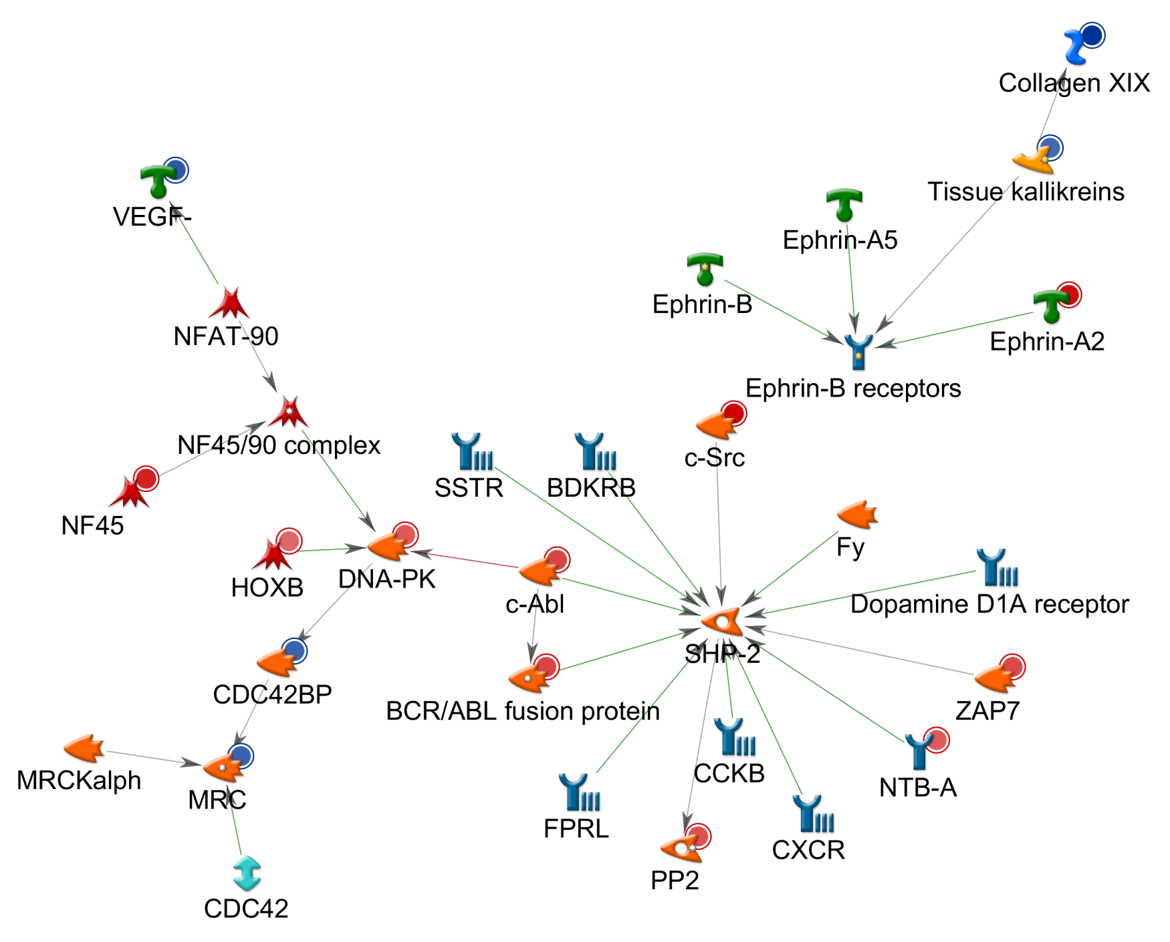
CDC42BPB NETWORK
Fig S8

