Slide 1
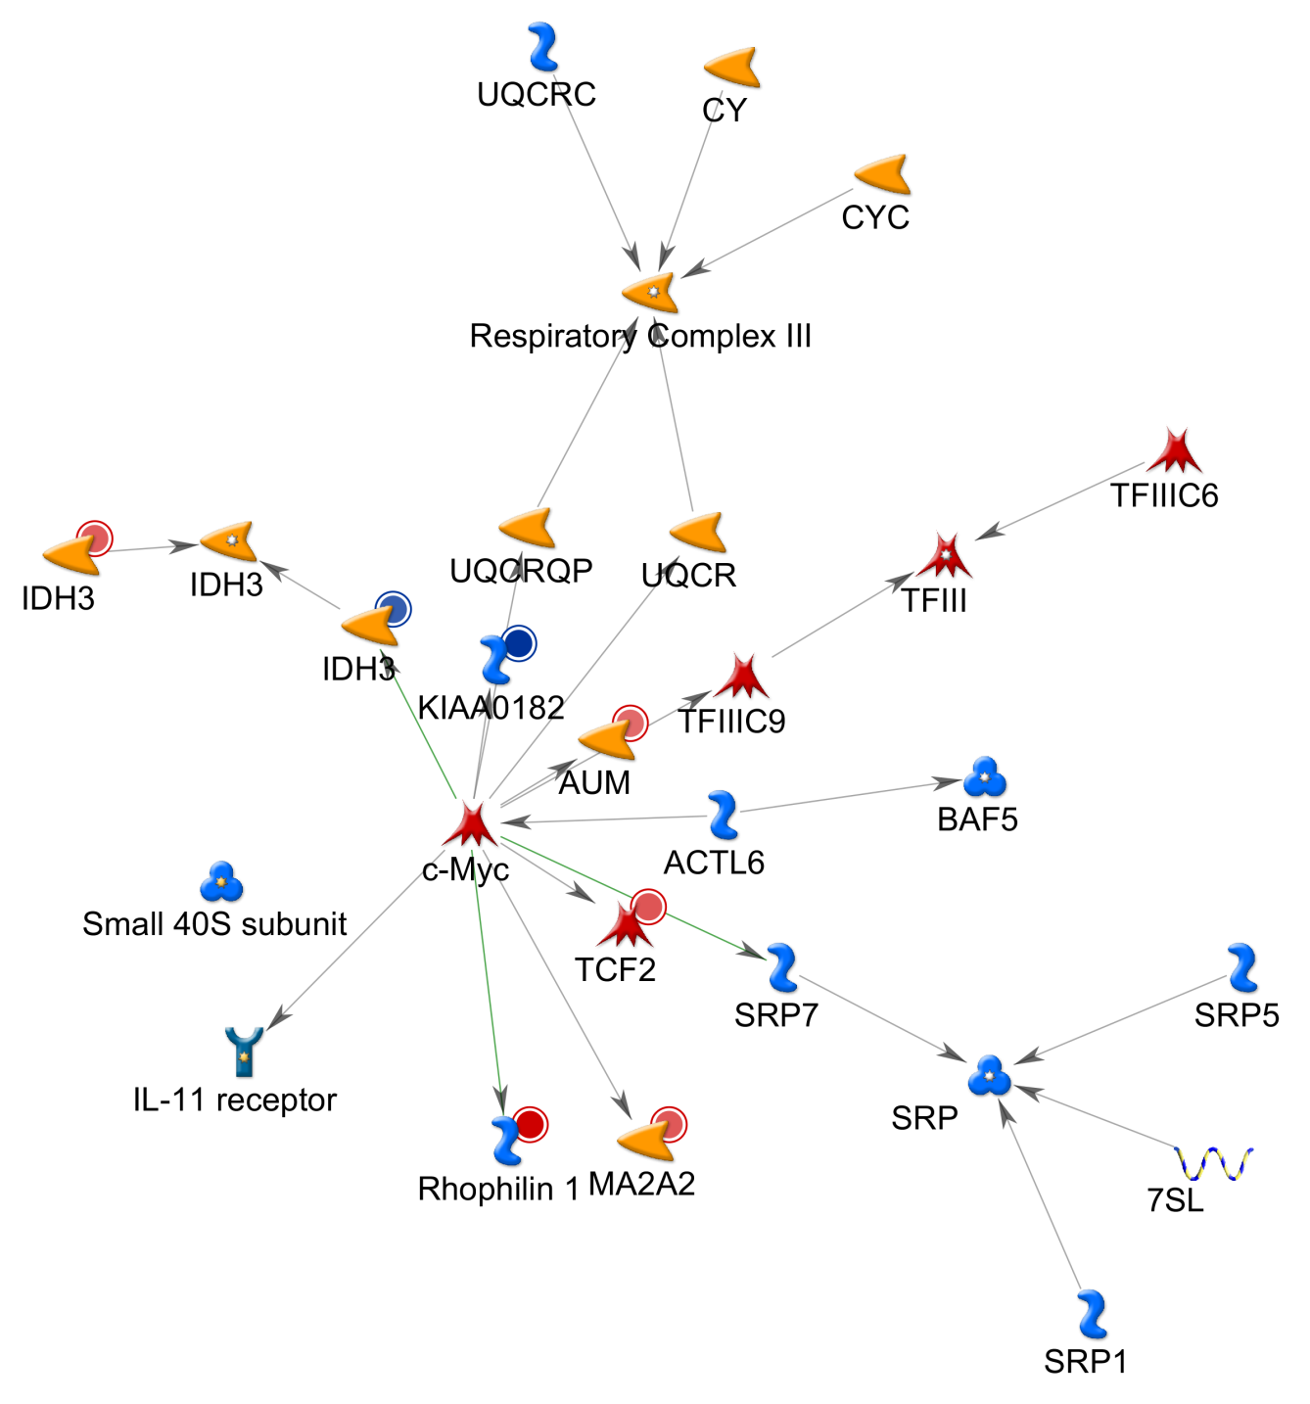
IDH3 NETWORK
Fig S9

