Slide 1
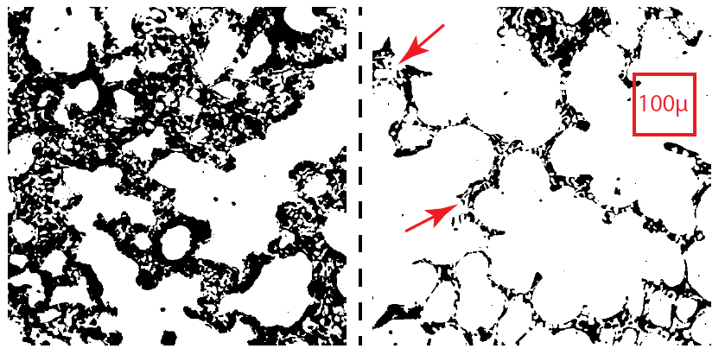
Fig. 1. Schematic representations of light micrographs of healthy rat lungs fixed at 7 cmH2O during ascending (left panel) and descending (right panel) airway pressure ramps . Collapsed alveoli are visible as thickened septa (arrows). The dimensions of a CT voxel (100 µm wide) are shown for comparison.
Reprinted from Respiration Physiology, Volume 15, Gill J, Weibel ER, Morphological study of pressure-volume hysteresis in rat lungs fixed by vascular perfusion, pp 190-213, 1972, with permission from Elsevier.

