Slide 1
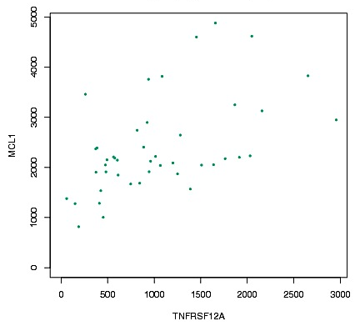
Figure S2
Squamous Cell Lung Cancer
n=44
r=0.53
P value=0.000025

