Slide 1
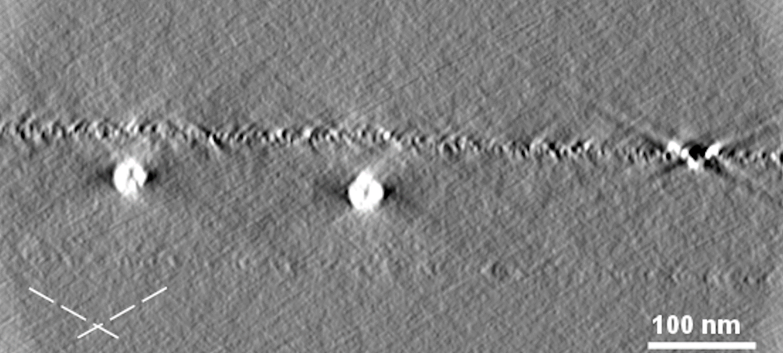
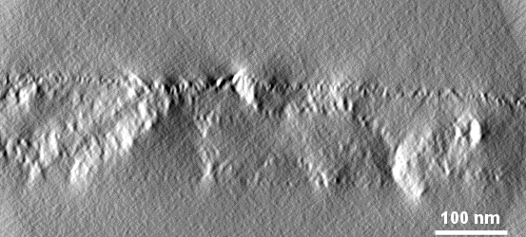
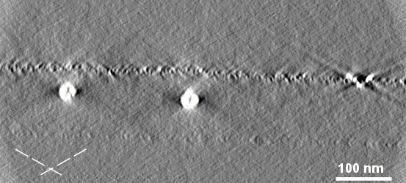
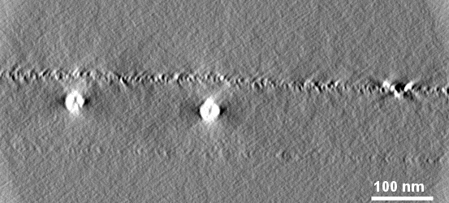


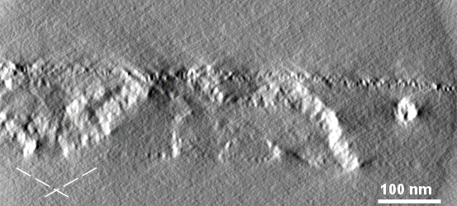



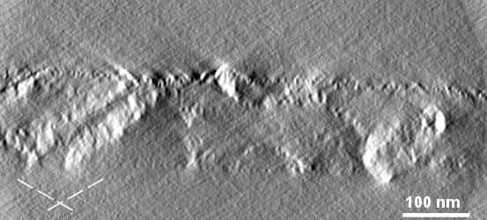

Effect of increasing length of the missing wedge ramp
126 projections from -65° to +60°, no angular filtering
resin-embedded section of hazel pollen grains

Slide 2

Effect of increasing length of the missing wedge ramp
missing wedge ramp: length: 12, order: 4, weight at the highest-tilt: 0.24
central stripe ramp: length: 24, order: 4, half-width: 12
resin-embedded section of hazel pollen grains

Slide 3

Effect of increasing length of the missing wedge ramp
missing wedge ramp: length: 25, order: 4, weight at the highest-tilt: 0.24
central stripe ramp: length: 24, order: 4, half-width: 12
resin-embedded section of hazel pollen grains

Slide 4

Effect of increasing length of the missing wedge ramp
126 projections from -65° to +60°, no angular filtering
resin-embedded section of hazel pollen grains

Slide 5

Effect of increasing length of the missing wedge ramp
missing wedge ramp: length: 12, order: 4, weight at the highest-tilt: 0.24
central stripe ramp: length: 24, order: 4, half-width: 12
resin-embedded section of hazel pollen grains

Slide 6

Effect of increasing length of the missing wedge ramp
missing wedge ramp: length: 25, order: 4, weight at the highest-tilt: 0.24
central stripe ramp: length: 24, order: 4, half-width: 12
resin-embedded section of hazel pollen grains

Slide 7

Effect of increasing length of the missing wedge ramp
126 projections from -65° to +60°, no angular filtering
resin-embedded section of hazel pollen grains

Slide 8

Effect of increasing length of the missing wedge ramp
missing wedge ramp: length: 12, order: 4, weight at the highest-tilt: 0.24
central stripe ramp: length: 24, order: 4, half-width: 12
resin-embedded section of hazel pollen grains

Slide 9

Effect of increasing length of the missing wedge ramp
missing wedge ramp: length: 25, order: 4, weight at the highest-tilt: 0.24
central stripe ramp: length: 24, order: 4, half-width: 12
resin-embedded section of hazel pollen grains

