Slide 1
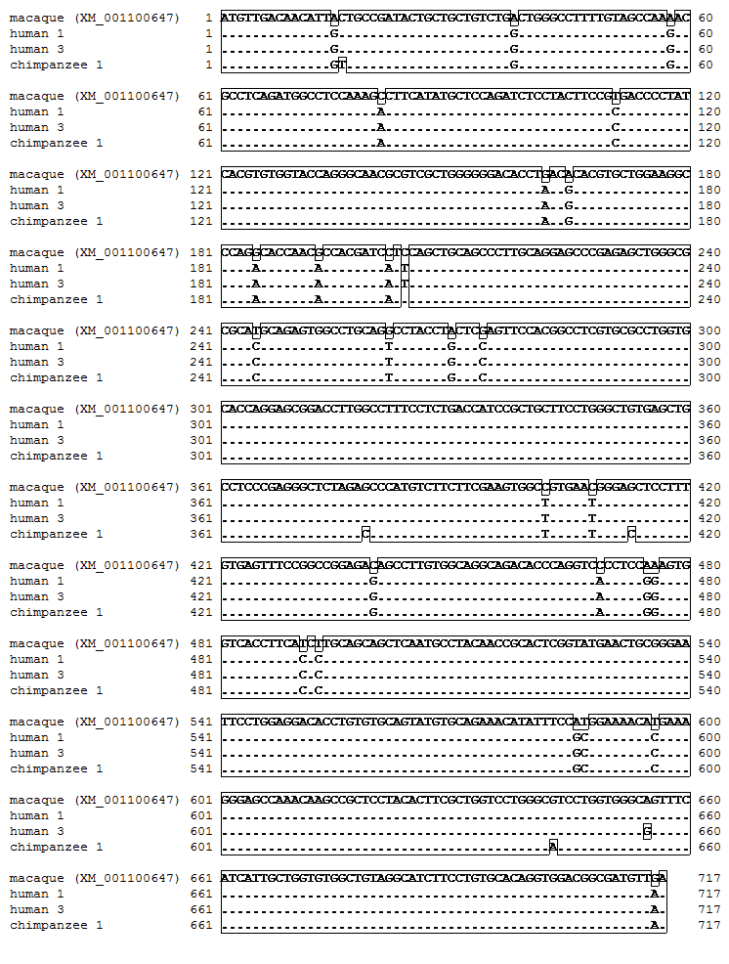
Additional file 2. Multiple sequence alignment of the coding region of PROCR.

