Slide 1
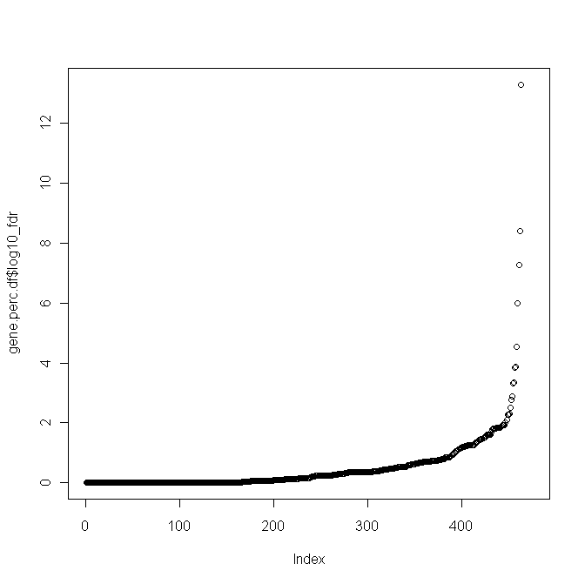
Identification of miRNA_{apt} and assessment of influenced genes sets/pathways/signatures
a)
b)
1.
List of miRNA candidate targets are identified using different prediction algorithms (miRanda, PicTar, TargetScan, mirBase, miRTarget2, TarBase)
Enrichment for anti-correlated predicted targets
-log10 FDR
43 miRNAapt
(Fisher test FDR < 0.05)
2.
For each miRNA, transcriptional correlations with predicted targets are calculated
FDR = 0.05
miRNAs
3.
Checks that predicted targets are enriched for anti-correlated genes (Fisher-test based q-value < 0.05). If so, the miRNA is labelled as a miRNAapt
signature gene set (e.g. “FGF SIGNALING”)
genes resulting as candidate targets and anti-correlated to the miRNA_{ap}
4.
For each miRNA_{apt} lists of anti-correlated candidate targets (assumed to be “bona fide” miRNA_{apt} targets) are screened for gene set enrichment using a large compendium of gene sets representing pathways and transcriptional signatures
statistical significance of the overlap (FDR on Fisher test)
Notes:
Step iii) notes:
size reference: ~20k genes
size_set: predicted targets eg. 200
size_list_input: anti_correlated targets eg: 1000
overlap: anti_correlated & predicted targets eg: 50
checks whether the predicted targets contain more anti-correlated genes than random genes

