Slide 1


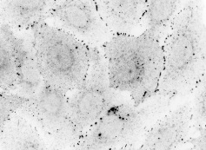
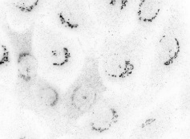


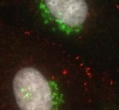
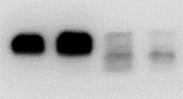
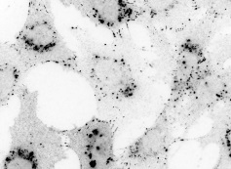
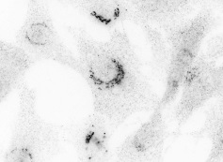
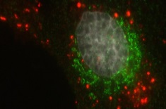

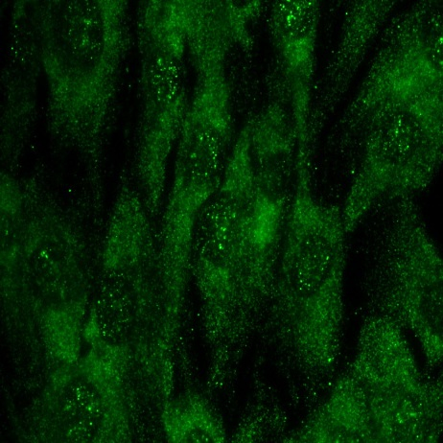
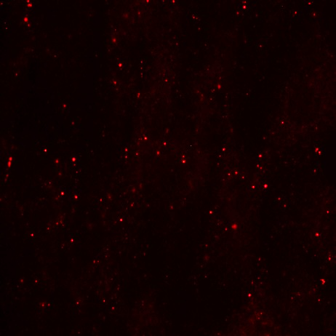
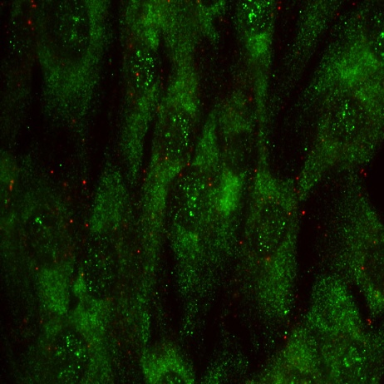
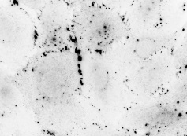
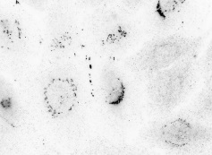
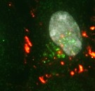
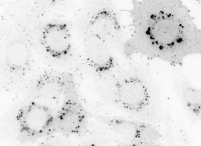
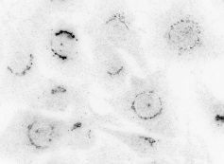
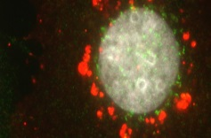
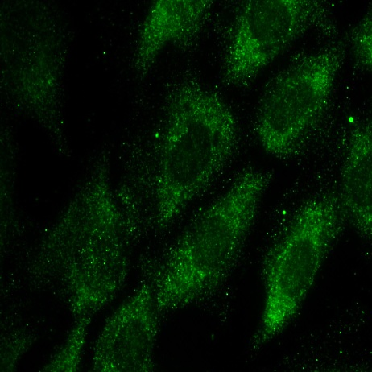
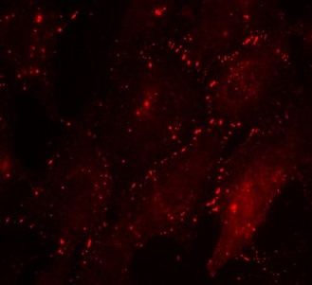
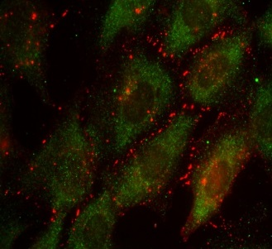
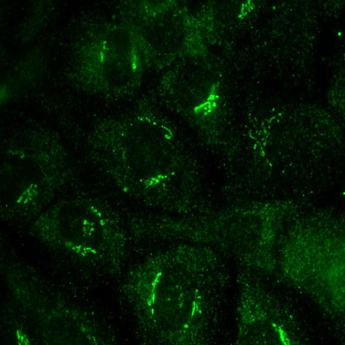

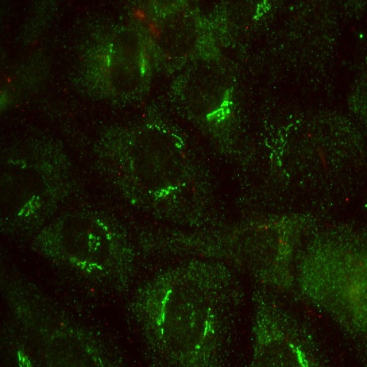


a
IP:Cx43
b
IP:Cx43
c
IP:Cx43
Cx43^{-/-}
Wt
None
Rapamycin
Control
Atg16KD
I
IP
FT
I
IP
FT
I
IP
FT
I
IP
FT
I
IP
FT
I
IP
FT
Vps34
Vps34
Vps34
Cx43
Cx43
d
Serum +
Beclin
e
HOM
AV
Cx43
Atg14
Atg14
F Stv
F Stv
Atg14
GAPDH
Atg5
LC3
I
II
Chloroquine
Cx43
GRP94
g
Serum -
Atg14
Cx43
Merged
Cx43
Atg14
Control
Chloroquine
Atg7(-)
f
IP: GFP
None
ΔCT₂₄₅-Cx43
I IP FT
I IP FT
GFP
Cx43(-)
Atg14
IgG
Cuervo.- Supplementary Figure 5

