Slide 1
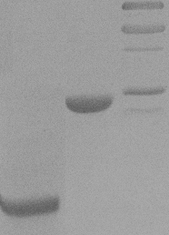
6 7
4 5
kDa
1 2 3
kDa
kDa
75
75
75
50
50
50
37
37
25
37
20
25
20
25
15
20
15
10
15
Purified HypA, UreE, UreG and HypB.
15% SDS-polyacrylamide gel showing proteins purified by ion-exchange and size exclusion chromatography. Lane 1, purified HypA (predicted molecular mass: 13.2 kDa); lane 2, purified UreG (22 kDa) ; lane 4, purified UreE (19.4 kDa); lane 6, purified HypB (27.3 kDa); lanes 3, 5 and 7, molecular mass standards with sizes indicated on the right of each panel.
Supplemental Figure 1

Slide 2
HypA-UreE binding in the presence of added metals. 5 μM UreE as analyte was allowed to bind to immobilized HypA with or without 1 mM Ni (II) or Zn (II). No significant difference was observed.
Supplemental Figure 2

Slide 3
BLI steady-state binding analysis of biotinylated UreG to analyte UreE in the absence of zinc. Fit to a saturation binding isotherm generates a K_{D} of 14 µM, with a 95% confidence interval of 8.6-18.9 µM.
Supplemental Figure 3

Slide 4
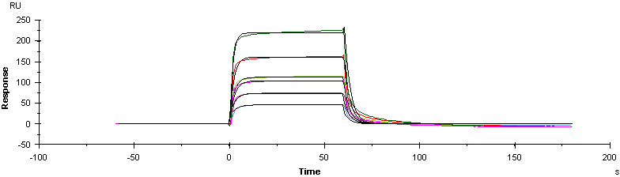
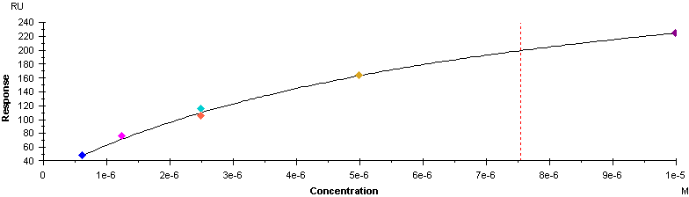
A
B
SPR analysis of UreG-UreE binding.
A. Biotinylated UreG (average of ~650 RU) was tethered to a Biotin CAP chip and exposed to analyte UreE ranging from 625 nM-10 µM. Raw data are shown with fits to a two-state parallel model. Rate constants were too fast for the instrument to determine.
B. Steady-state analysis yielded a K_{D} of 7.6 µM.
Supplemental Figure 4

Slide 5
BLI sensorgrams showing binding of 5 µM UreE analyte to UreG (ligand) in absence or presence of Zn and EDTA.
Biotinylated UreG as ligand binding to 5 µM UreE in the presence (red) or absence (black) of 1 mM Zn²⁺ association (0-300 s) and dissociation (300-600 s) phases. Negligible binding of UreE to sensor only (i.e. no ligand UreG; no zinc, green; 1 mM zinc, blue) indicates real change in specific binding consistent with substantially altered kinetics likely due to change in oligomeric state. Orange and brown traces indicate experiments in which 5 mM EDTA was present in dissociation. The increased fast dissociation rate supports the conclusion that the increased stability is zinc-dependent. Some additional fast-off phase in the –zinc + EDTA (brown) trace suggests the presence of metal in the purified complexes.
Supplemental Figure 5

Slide 6
Addition of GTP has no significant effect on interactions between UreG and any other protein. UreG was used as ligand and tested in presence of 5 mM GTP against 5 μM HypA (red), HypB (blue), UreE (orange) or UreG (green). Only binding to UreE was observed. A trace in the absence of GTP (black) is shown for comparison.
Supplemental Figure 6

