Slide 1
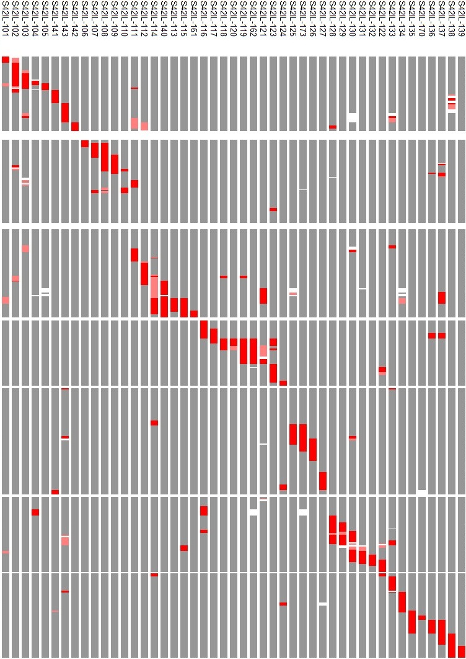
1H
25 cM
2H
3H
4H
5H
6H
7H
Homozygote ISR 42-8
Heterozygote
Homozygote Scarlett
Missing data
Figure S1: Map of 47 S42ILs, the map contains 636 BOPA1 SNPs (modified after Schmalenbach et al. 2011).

