Slide 1
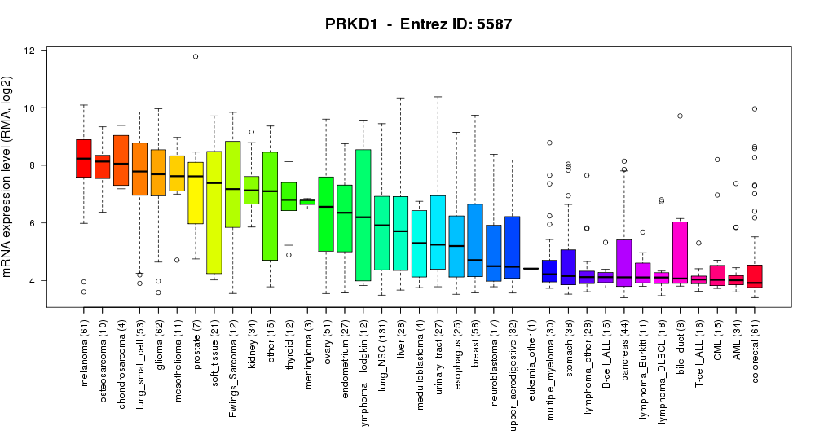
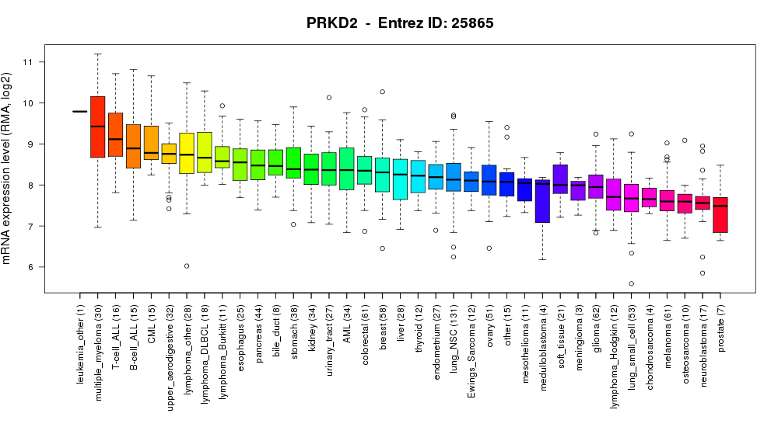
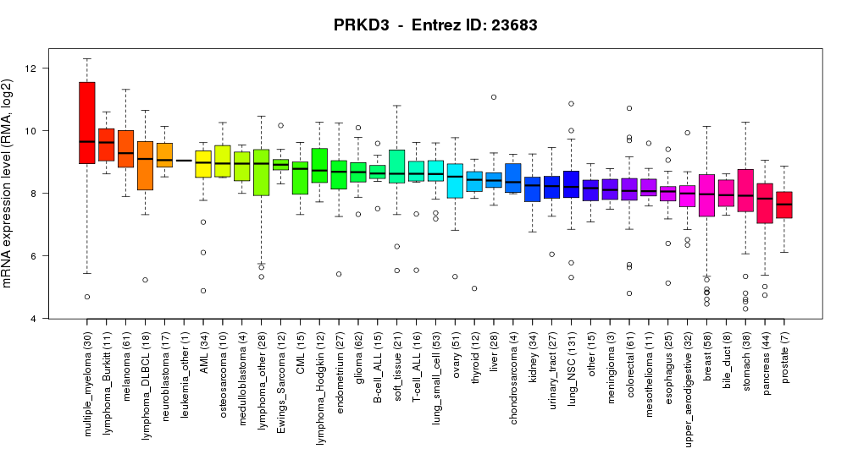
Fig. S2. PKD1, PKD2 and PKD3 mRNA expression in cell lines from the Cancer Cell Line Encyclopedia database. Average mRNA expression in the 61 colorectal cell lines is highlighted in the red box.

