Slide 1

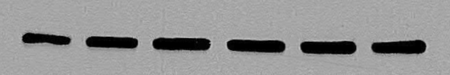
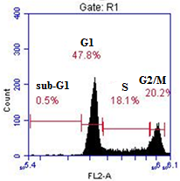
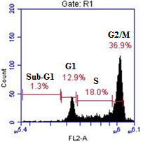
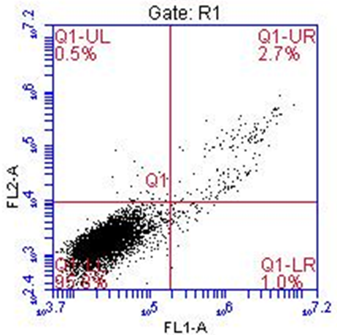
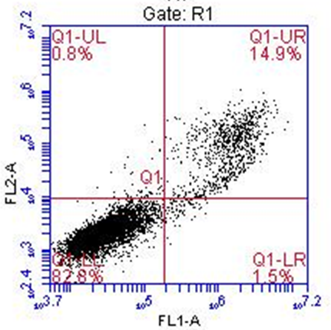
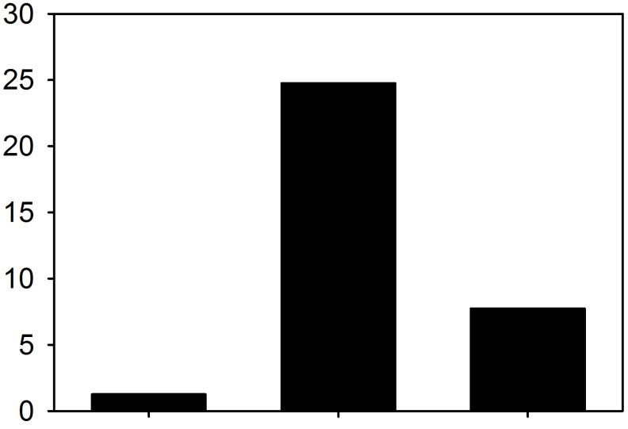
A
p-PKD2
α-Tubulin
- + + + + + PMA
- - 3 10 30 100 kb-NB142-70 (μmol/L)
B
C
D
E
Control
kb-NB142-70 (10 μmol/L)
F
NF-κB activity
- + + TNF-α
- - 10 kb-NB142-70 (μmol/L)
Fig. S3. Effect of kb-NB142-70 on RKO cell cycle, apoptosis, and NF-κB activity. Cells were incubated in the absence or presence of kb-NB142-70 for 24 hours. PMA (100 nmol/L) was added to cells 30 minutes prior to harvesting for Western blot analysis (A). Cells were also processed for cell cycle analysis (B,C) and apoptosis induction (D,E) after kb-NB142-70 incubation (10 µmol/L). (F) Effect of kb-NB142-70 on NF-κB activity was determined by the dual-luciferase assay.

