Slide 1
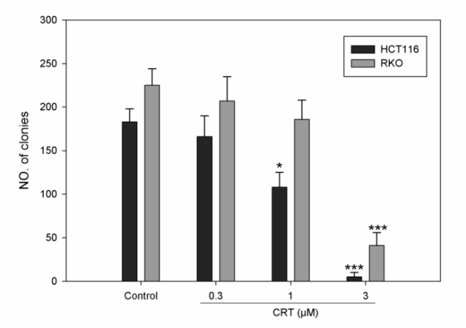
Fig. S4. Effect of PKD inhibitor on clonal formation. Cells were incubated with CRT0066101 for 24 hours. After 10-14 days, colonies (>50 cells) were fixed and manually counted. Colony values represent the mean ± SD from 3 independent clonogenic assays performed in duplicate.

