Slide 1
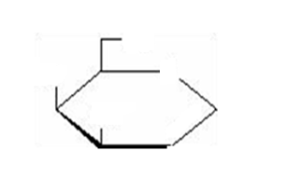
Additional file 1
OH
OH
HO
O
D-glucose
OH
OH
OH
HO
O
D-glucal
OH
OH
D-galactal
O
OH
HO

