Slide 1
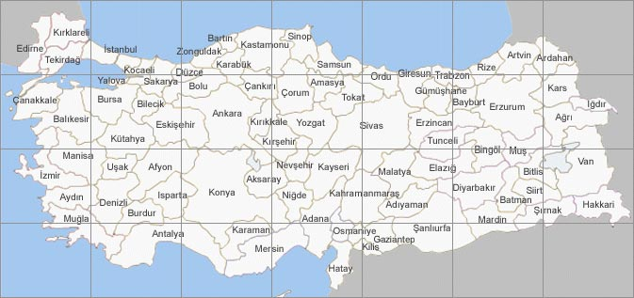
Figure 3
# D80Y
Δ R312X
Δ R312X
L7P
*
I249T
& M1I
▲ N296fX54
L7P
◙ D168N
A
B
C
D
E
F
G
#
&
Δ
Δ
*
◙
*
Δ
▲
▲
Centers where the patients were presented

