Slide 1
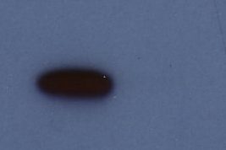
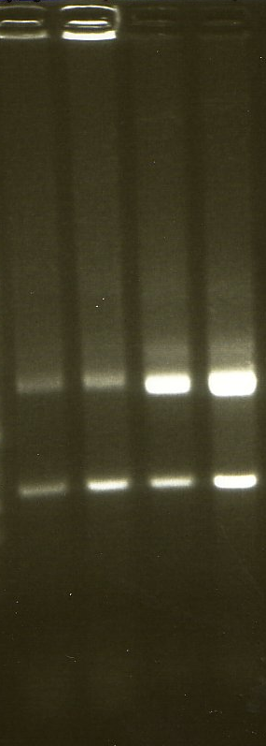
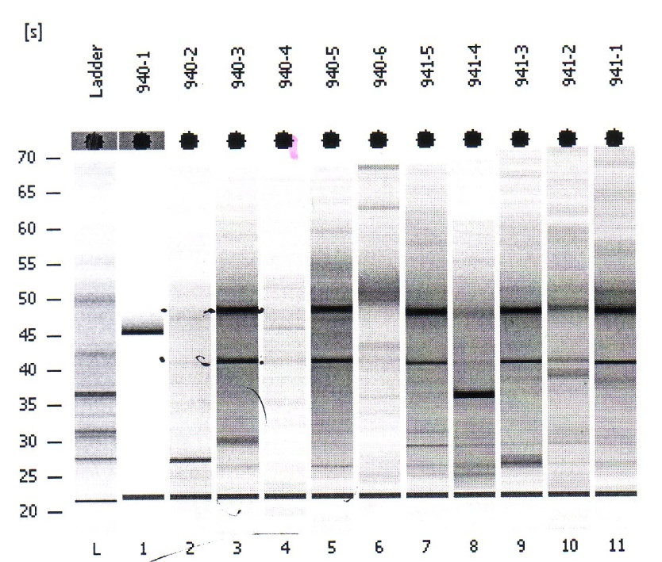
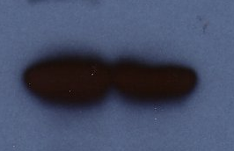
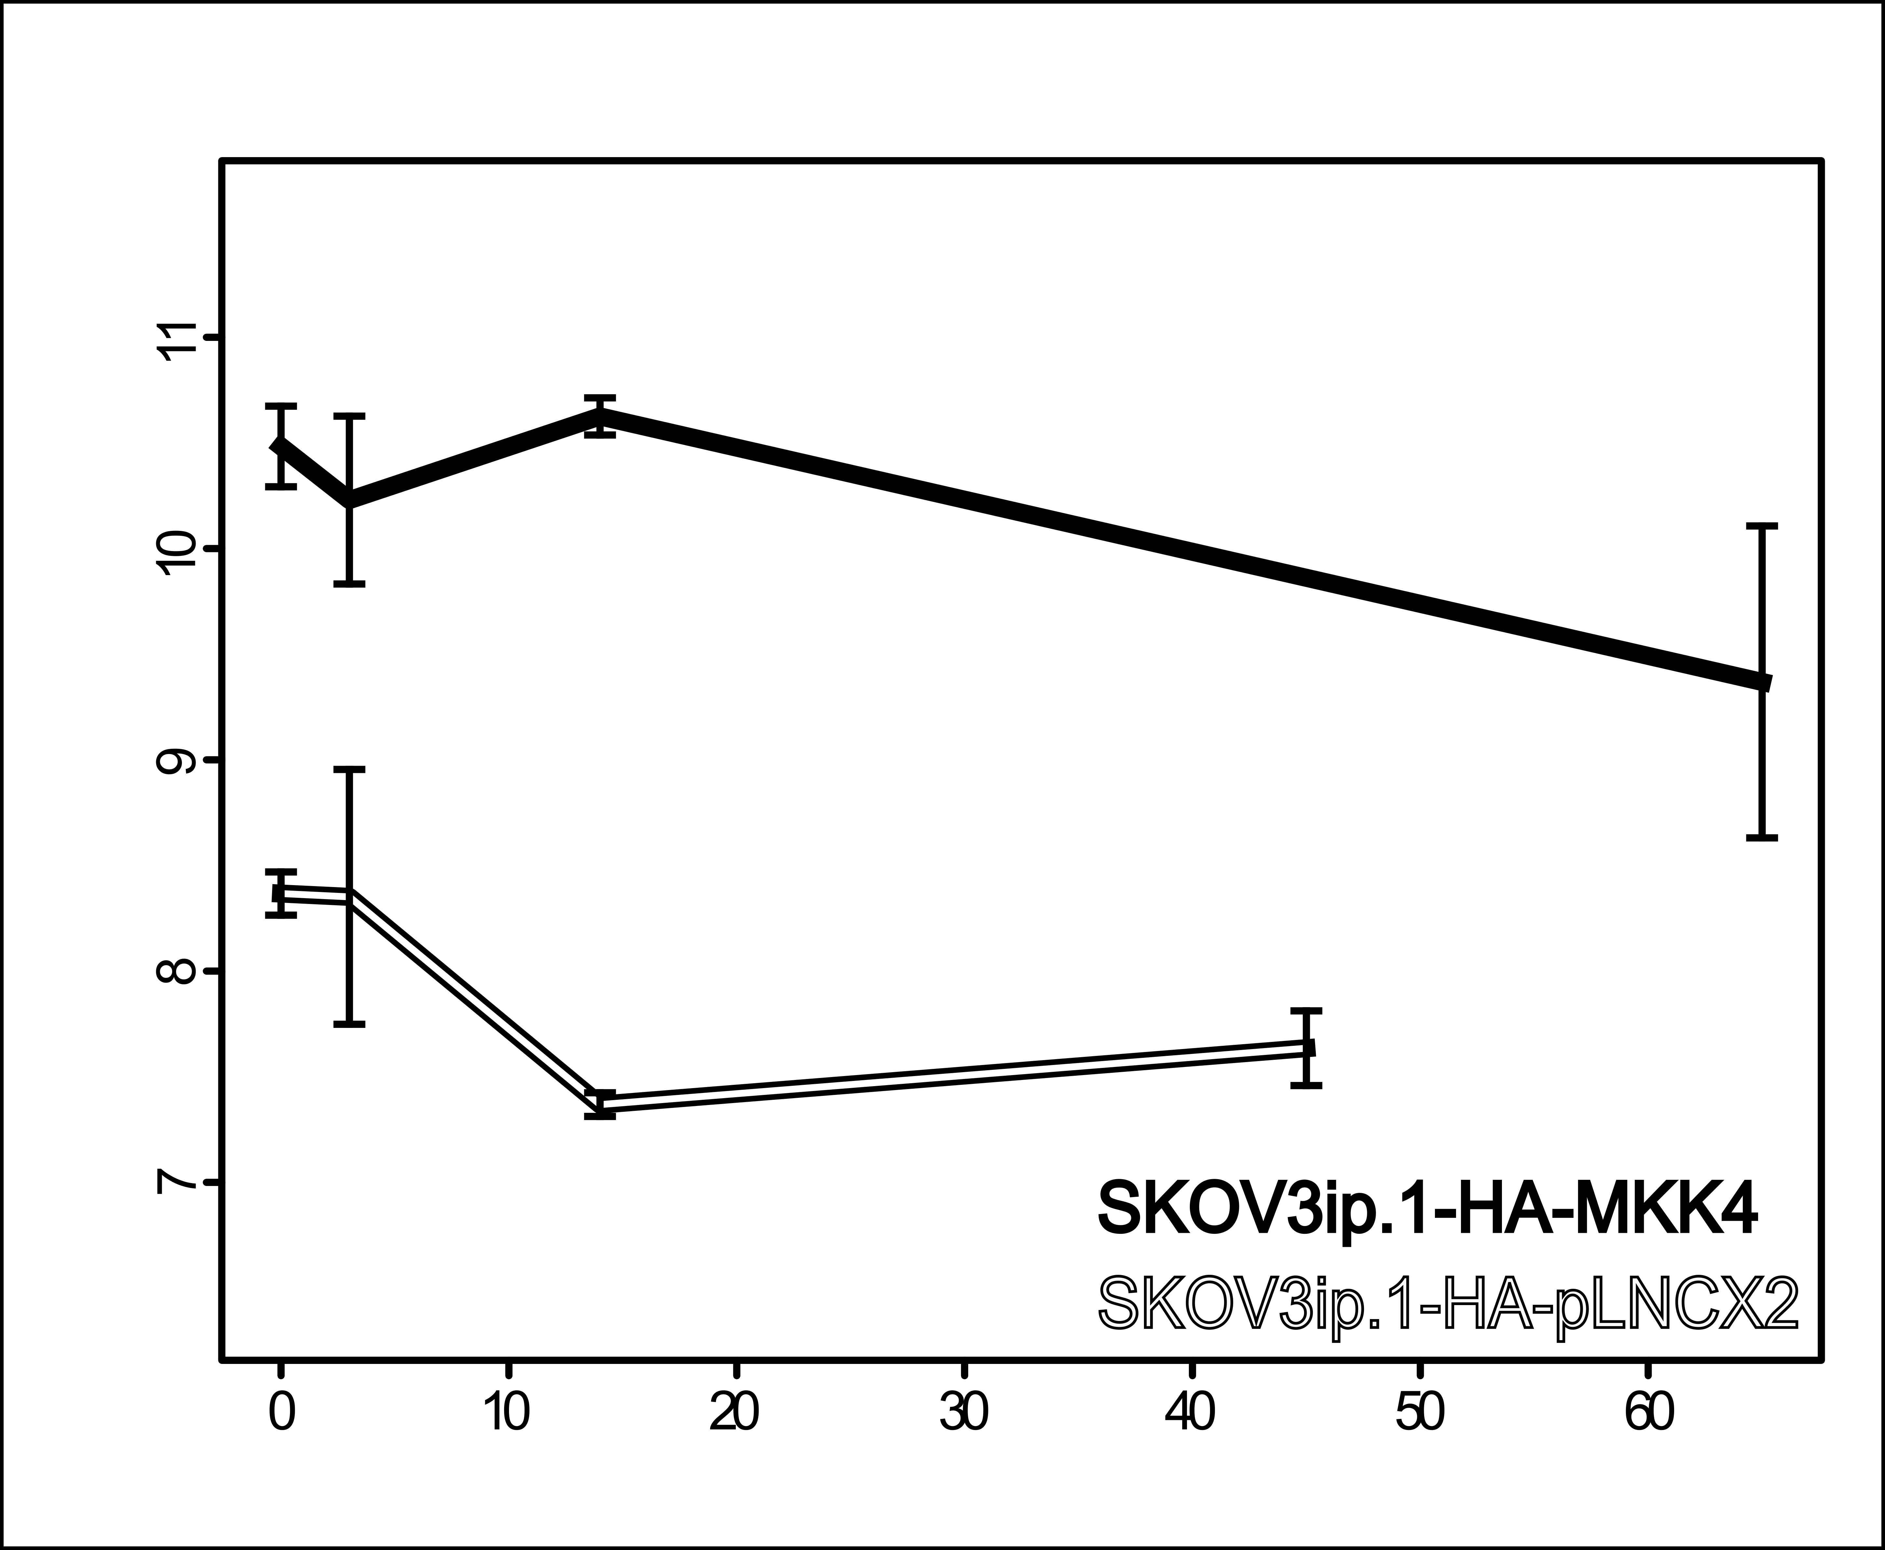
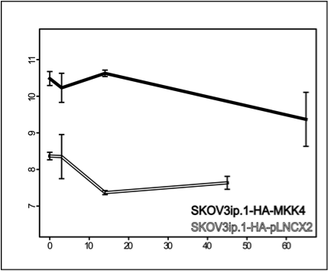
Bainer and Veneris, et al. Supplemental Figure S1
A
B
C
24 hr -80ºC, H&E
H&E, 25 ºC 15 min
24 hr -80ºC
HA-MKK4
Unstained
HA-MKK4
Vector
Vector
1
2
1
2
HA-MKK4
(HA.11 antibody)
Actin
28S
28S
18S
18S
D
11
10
9
Expression Estimate
(Arbitrary Units)
8
7
0
10
20
30
40
50
60

