Slide 1
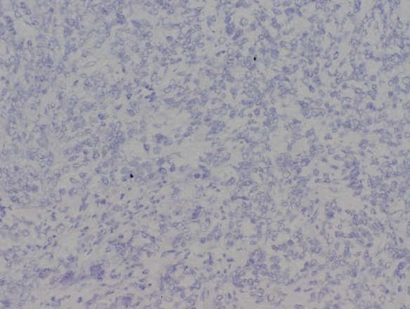
Bainer and Veneris, et al. – NEW Figure S6
A
ASPM
IgG
Vector
MKK4
B
PECAM-1
IgG
Vector
MKK4

Slide 2
Supplemental Figure SX. Immunohistochemistry of early metastases and associated negative controls. Immunohistochemistry of frozen sections from tissues harvested at 14 dpi. Panel A Representative images of ASPM staining and Panel B PECAM-1 staining are shown with associated negative controls. Negative controls were performed using Rabbit IgG as described in the Methods. Scale bars represent 100 µm.

