Slide 1
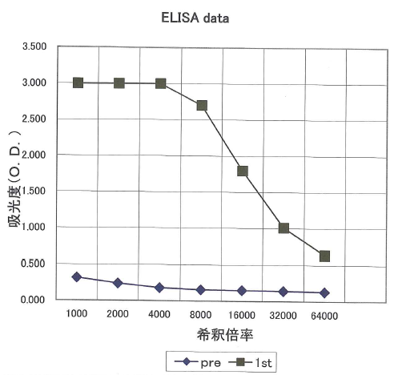
The ELISA data of rabbit anti D-AIB AT antibody. The titer of the antibody was assessed by enzyme-linked immunosorbent assay.
◆; pre-immune rabbit serum, ■; anti-D-AIB AT antibody
absorbance (O.D.)
dilation ratio

