Slide 1
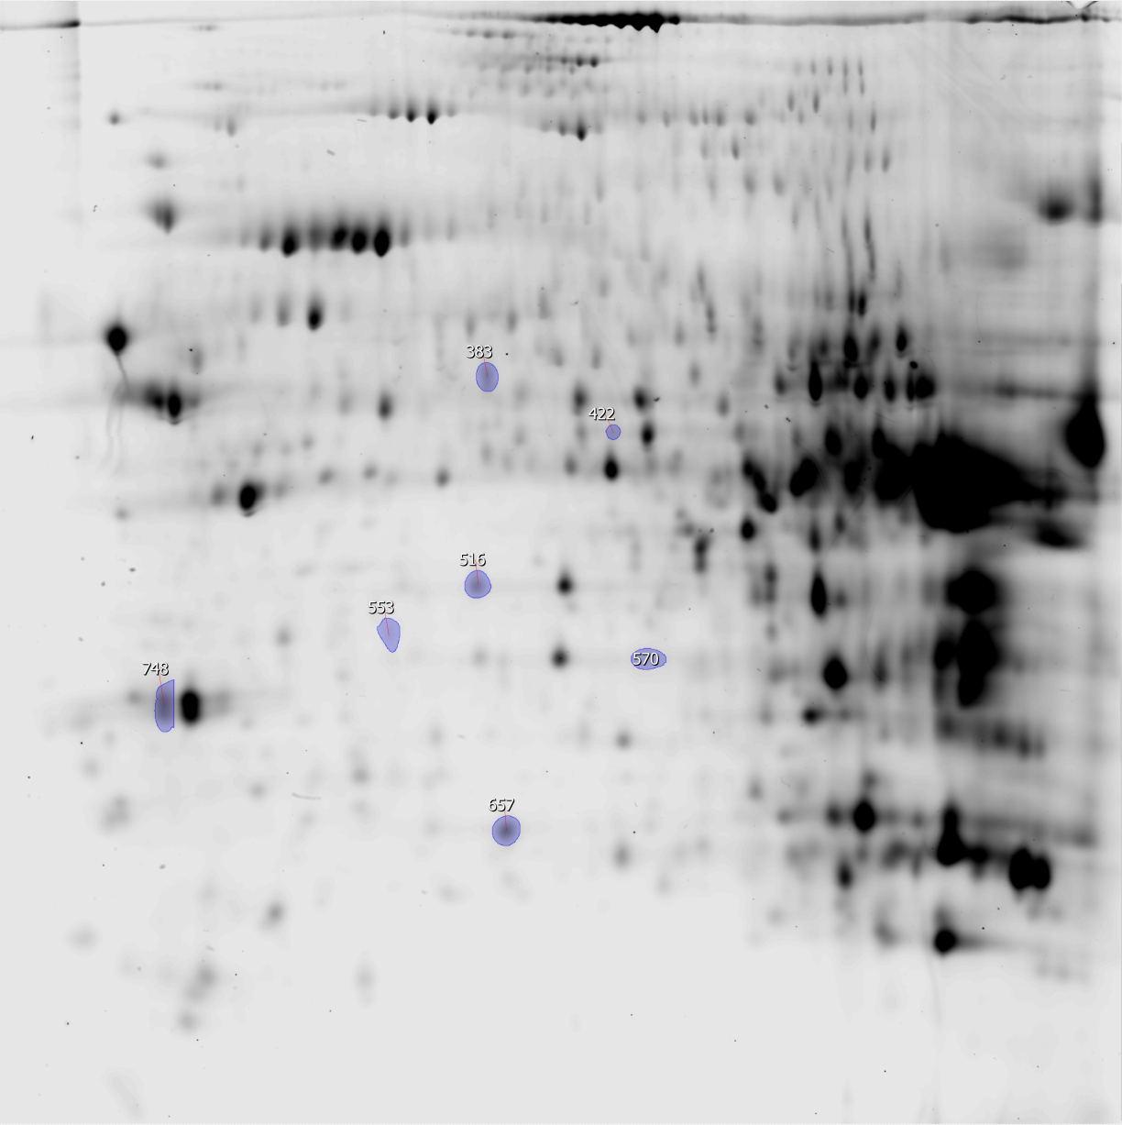
Title:
Litter size manipulation in laboratory mice: an example of how proteomic analysis can uncover new mechanisms underlying the cost of reproduction
Marine I. Plumel^{1,3}, Antoine Stier ^{2,3}, Danièle Thiersé^{1,3}, Alain van Dorsselaer^{1,3}, François Criscuolo^{2,3$} and Fabrice Bertile^{1,3*$}
¹ Institut Pluridisciplinaire Hubert Curien, Département Sciences Analytiques, CNRS UMR7178, 25 rue Becquerel, 67087 Strasbourg Cedex 2, France
² Institut Pluridisciplinaire Hubert Curien, Département d’Ecologie, Physiologie et Ethologie, CNRS UMR7178, 23 rue Becquerel, 67087 Strasbourg Cedex 2, France
³ University of Strasbourg, 4 rue Blaise Pascal, F-67081 Strasbourg Cedex, France
$: Equal contributors, shared seniorship of the paper
*: corresponding author: fbertile@unistra.fr
3
pH
10
Supplementary Figure S1.
Representative 2D-gel image
of mouse liver proteins
Significantly different protein spots
according to ANOVA analysis (P<0,05) are shown)
200
MW (kDa)
10

