Slide 1
Cox-2^{flox/flox}
Cox-2^{flox/flox};LysMCre⁺
% of Apoptotic epidermal cells
n.s.
Supplemental Figure 1. Apoptosis in skin of UVB-irradiated Cox-2^{flox/flox};LysMCre⁺ and Cox-2^{flox/flox} mice.

Slide 2
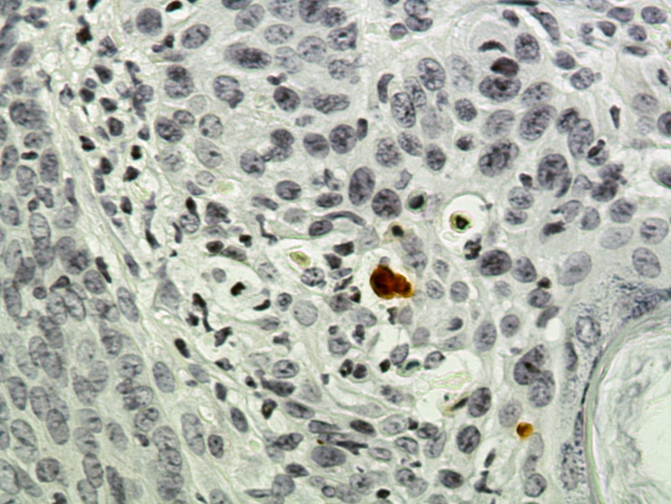
Cox-2 ^{flox/flox}
Cox-2^{flox/flox};K14Cre⁺
Cleaved- Caspase3
Supplemental Figure 2: Representative image of Apoptosis in papillomas section of UVB-irradiated Cox-2^{flox/flox};K14Cre⁺ and Cox-2^{flox/flox} mice. Red arrow indicates apoptotic cells (Cleaved-Caspase 3 positive).

