Slide 1
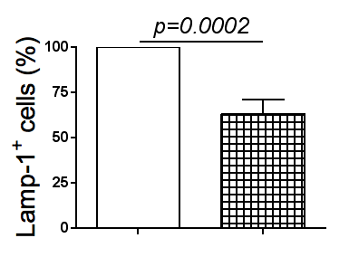
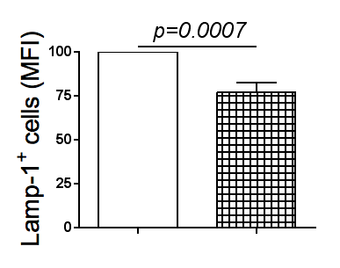
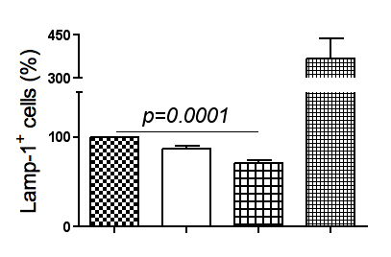
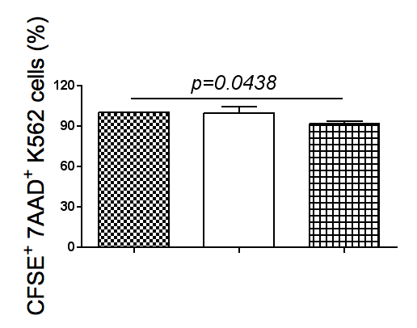
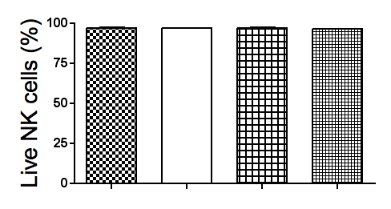
A.
IgG-coated beads
α-Tim-3-coated beads
IgG-coated beads
α-Tim-3-coated beads
B.
(-)
CD94
Tim-3
CD16
C.
K562
IgG-coated K562
α-Tim-3-coated K562
D.
(-)
CD94
Tim-3
CD16
FIG. S5

