Slide 1
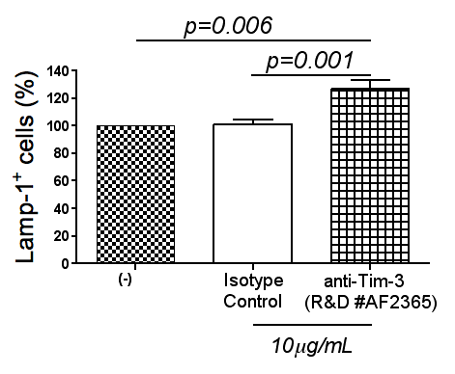
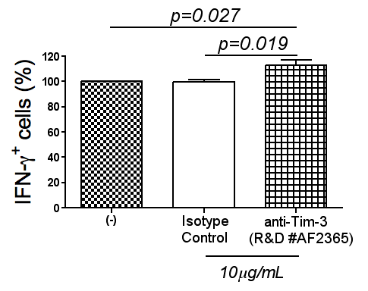
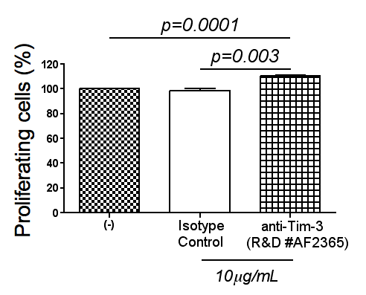
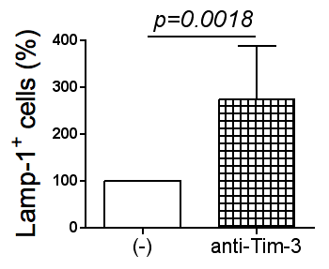
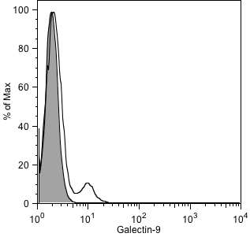
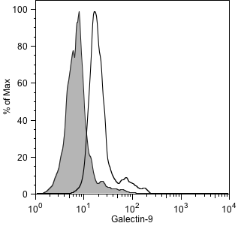
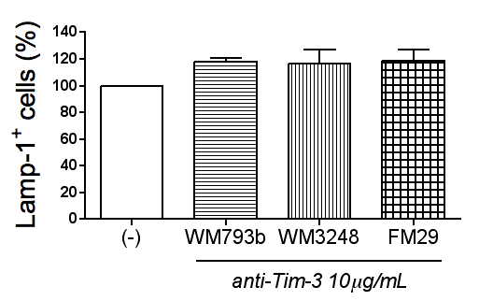
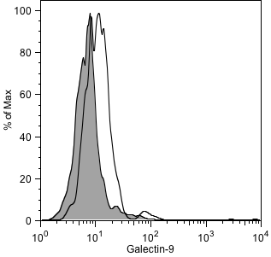
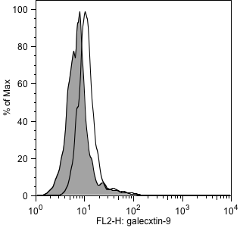
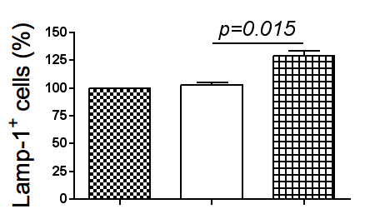
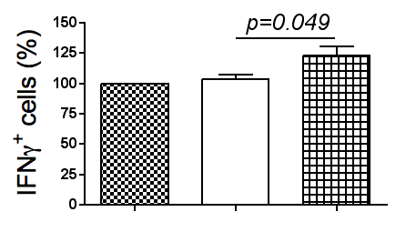
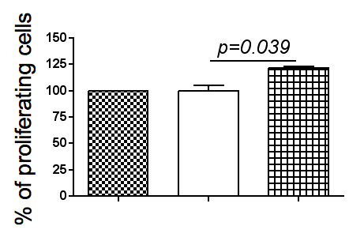
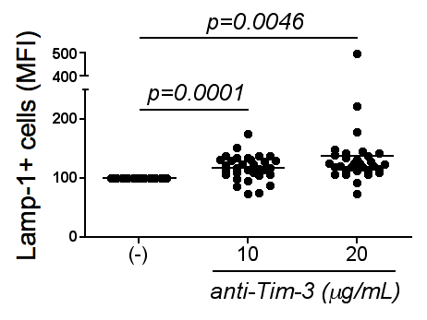
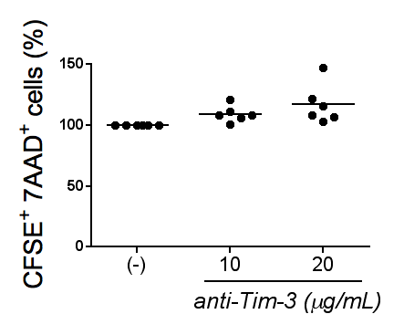
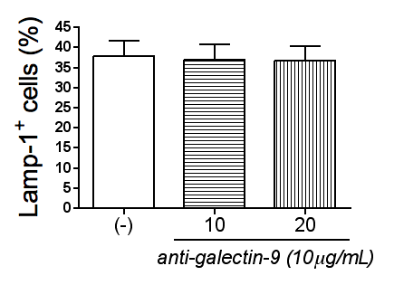
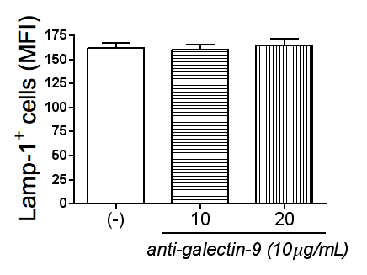
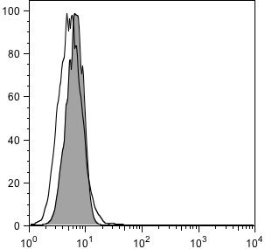
A.
B.
Target cells: WM1552
C.
FM29 Melanoma Cells
WM793 Melanoma Cells
% of Max
% of Max
IgG isotype control
Galectin-9
Galectin-9
Galectin-9
WM1552 Melanoma Cells
WM3248 Melanoma Cells
% of Max
% of Max
Galectin-9
Galectin-9
D.
(-)
Isotype
control
anti-Tim-3
(Clone 2E2)
(-)
Isotype
control
anti-Tim-3
(Clone 2E2)
(-)
Isotype
control
anti-Tim-3
(Clone 2E2)
10μg/mL
10μg/mL
10μg/mL
E.
F.
G.
K562 Cells
% of Max
Galectin-9
FIG. S7
IgG isotype control
Galectin-9

