Slide 1
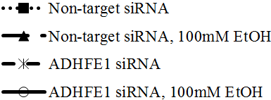
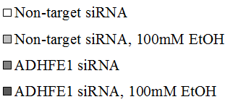
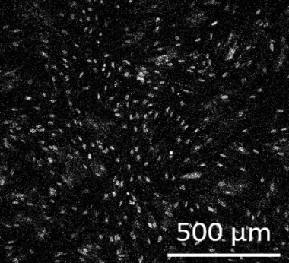
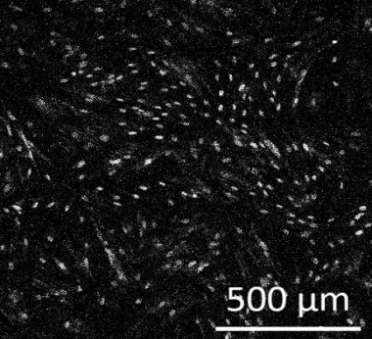

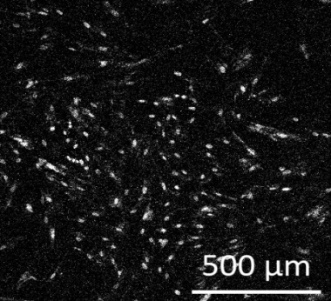
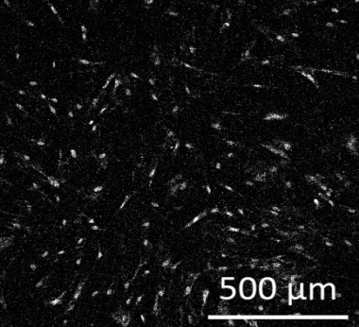

Figure S2
A
B
*
*
Cell viability
Number of counted cells (×10⁴)
*
Time (hours)
Time (hours)
C
D
Non-target
Non-target
EtOH
-
+
-
+
ADHFE1 siRNA
-
-
+
+
EtOH
ADHFE1
50kD
ADHFE1
ADHFE1
EtOH
GAPDH
37kD

