Slide 1
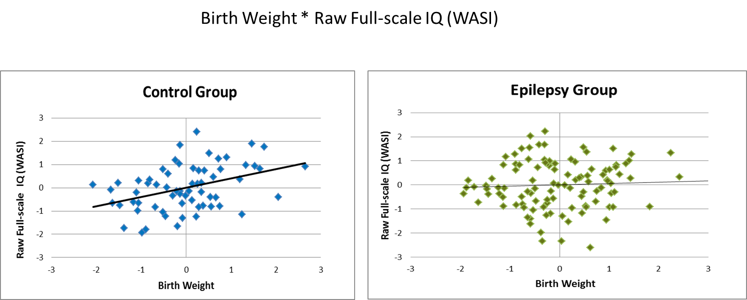
Birth Weight and Cognition in Children with Epilepsy
Objective: We aimed to determine if there are differences in birth weight between full term children with uncomplicated new/recent-onset epilepsies and typically-developing healthy controls. We further examined the relationships between birth weight and childhood/adolescent cognition, behavior, and academic achievement.
Methods: 108 children with new/recent-onset epilepsy and 70 healthy controls underwent neuropsychological assessment. All participants were born full-term (>37 weeks) without birth complications.
Results: Birth weight of children with epilepsy was significantly lower than healthy controls (p=0.023).
Significance: Although the origin of lower birth weight in children with epilepsy is unknown, these findings raise the possibility that abnormal prenatal environment may impact childhood-onset epilepsy.
Results: Whereas birth weight (covaried with age, sex, handedness, and mother’s education) was significantly associated with cognition in controls in multiple domains (intelligence, language, aspects of academic achievement), this relationship was absent in children with epilepsy.
Jackson et al, 2014

