Slide 1
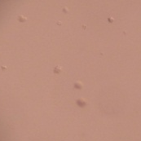
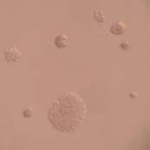
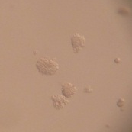








Supplemental Fig. 2
A
# of colonies/well
B
HRGα
HRG (min)
0
15
30
60
p-mTOR (S2448)
pan mTOR
p-TSC2 (T1462)
pan TSC2
p-AKT (T308)
p-AKT (S473)
pan AKT
p-S6 (S235/236)
pan S6
actin

