Slide 1
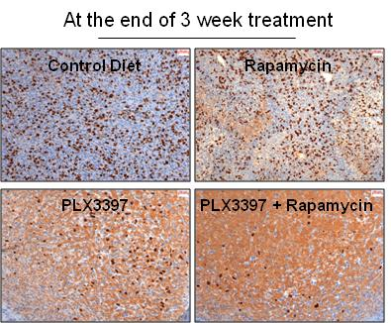
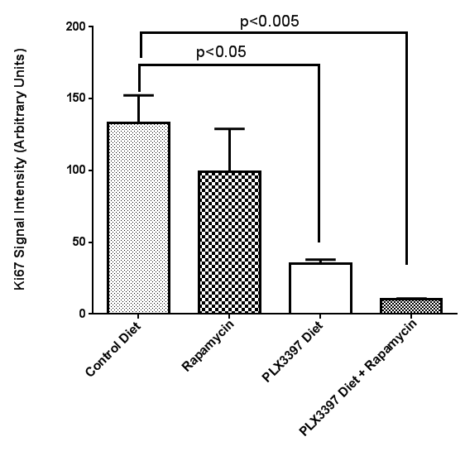
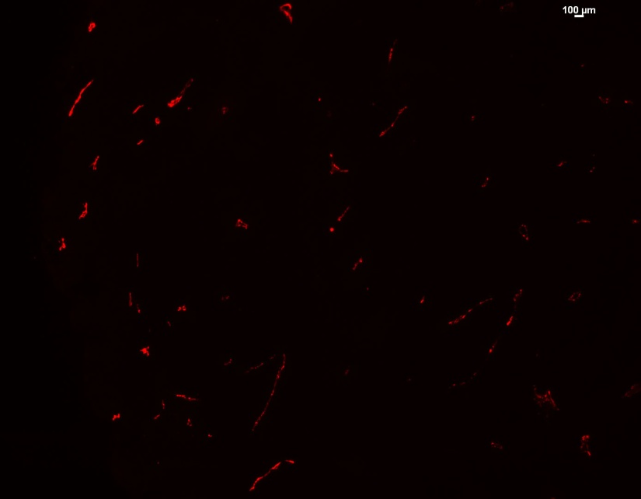
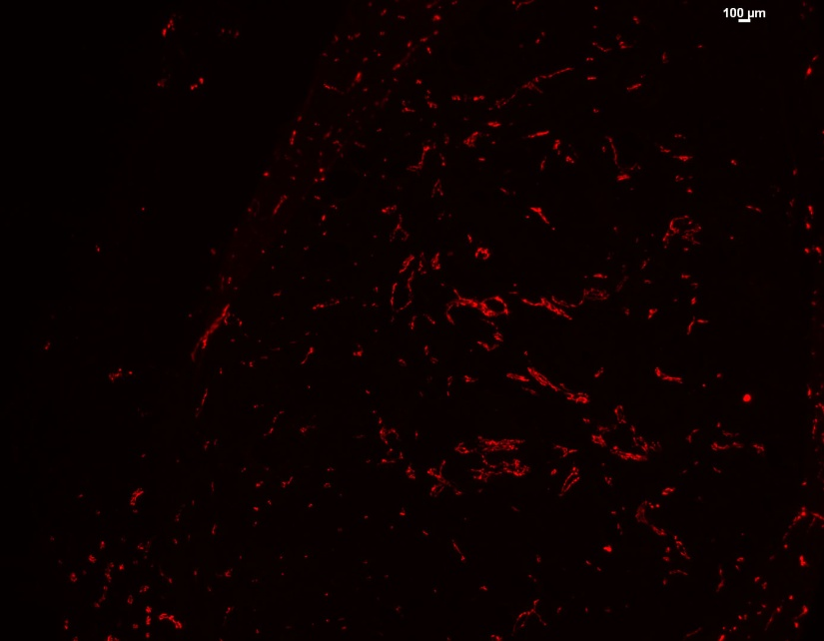
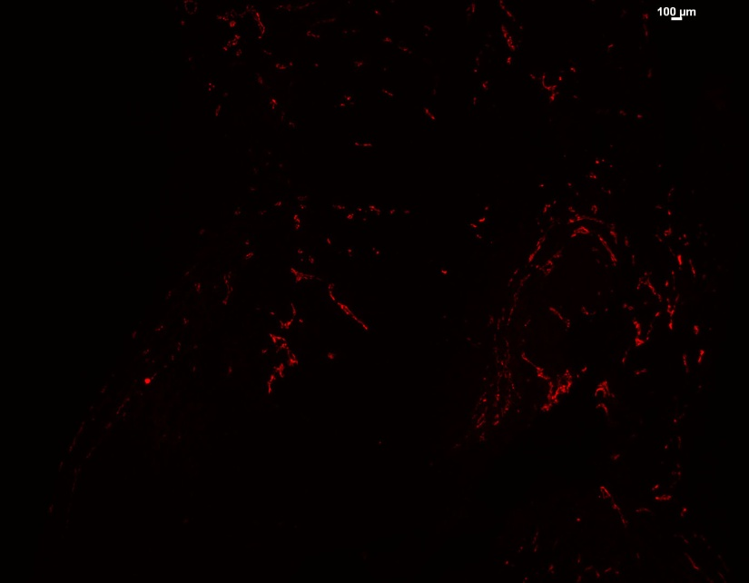
Supplemental Figure 5
A.
B.
C.
CD31
Control Diet
CD31
Rapamycin
CD31
PLX3397 Diet
CD31
PLX3397 Diet + Rapamycin

