Slide 1
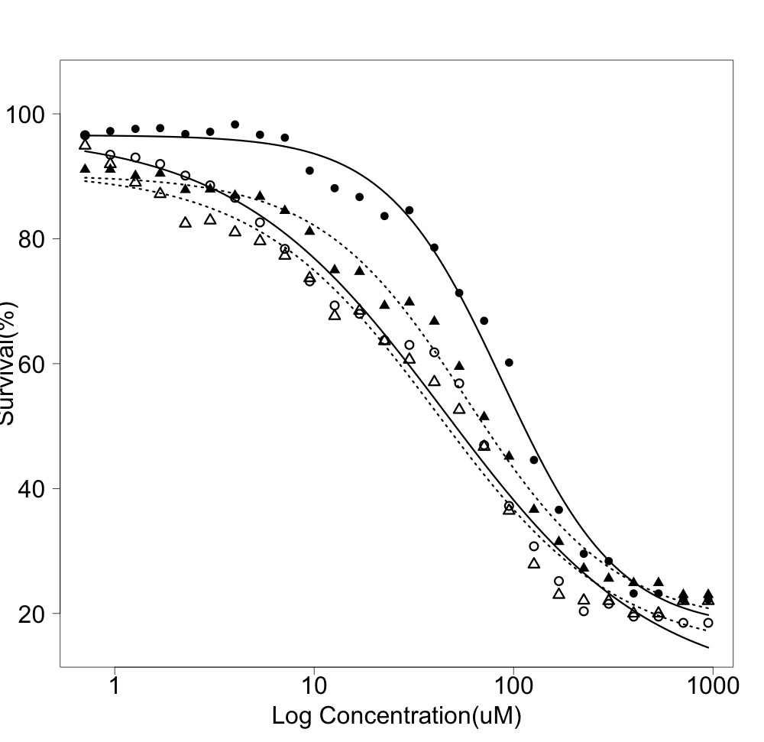
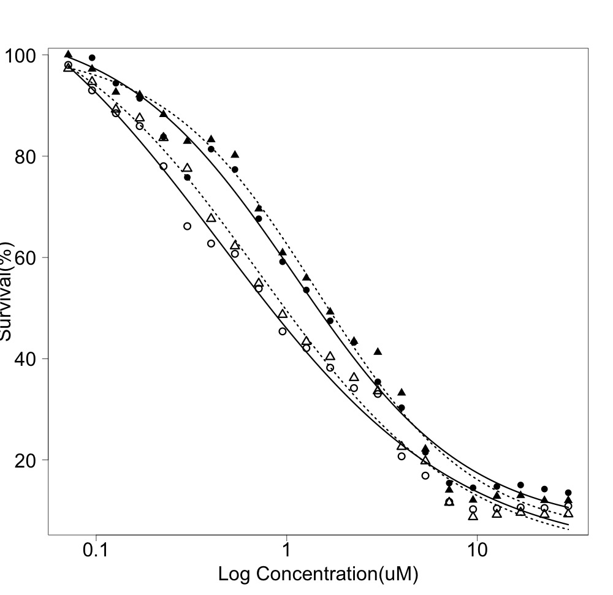
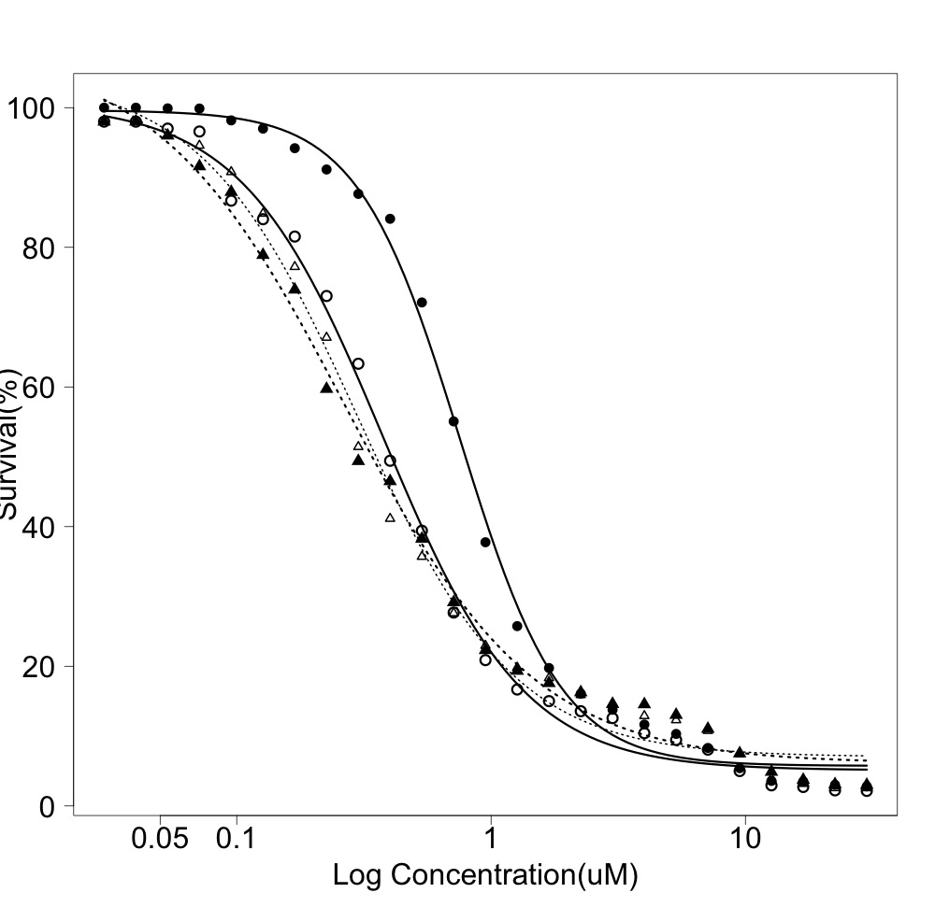
a
b
MCF7_M2
A549_M2
Percentage survival
Percentage survival
log[cisplatin] (uM)
log[cisplatin] (uM)
c
HEK293_M2
d
IC₅₀ cisplatin treatment
Percentage survival
A549_M2
MCF7_M2
HEK293_M2
Empty vector, no dox 718nM 41.06uM 298.1nM
Empty vector, with dox 1,454nM 58.59uM 267.2nM
RHOXF2 vector, no dox 448nM 44.91uM 376.2nM
RHOXF2 vector, with dox 1,099nM 88.17uM 752.5nM
Additional File 10
log[cisplatin] (uM)

