Slide 1
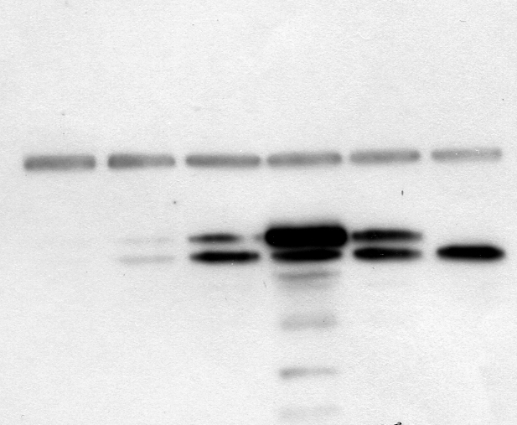
dox μg/ml
0
0.004
0.016
0.032
0.063
2
α-tubulin
55-kDa
*
DHFR
28-kDa
Additional File 3

