Slide 1
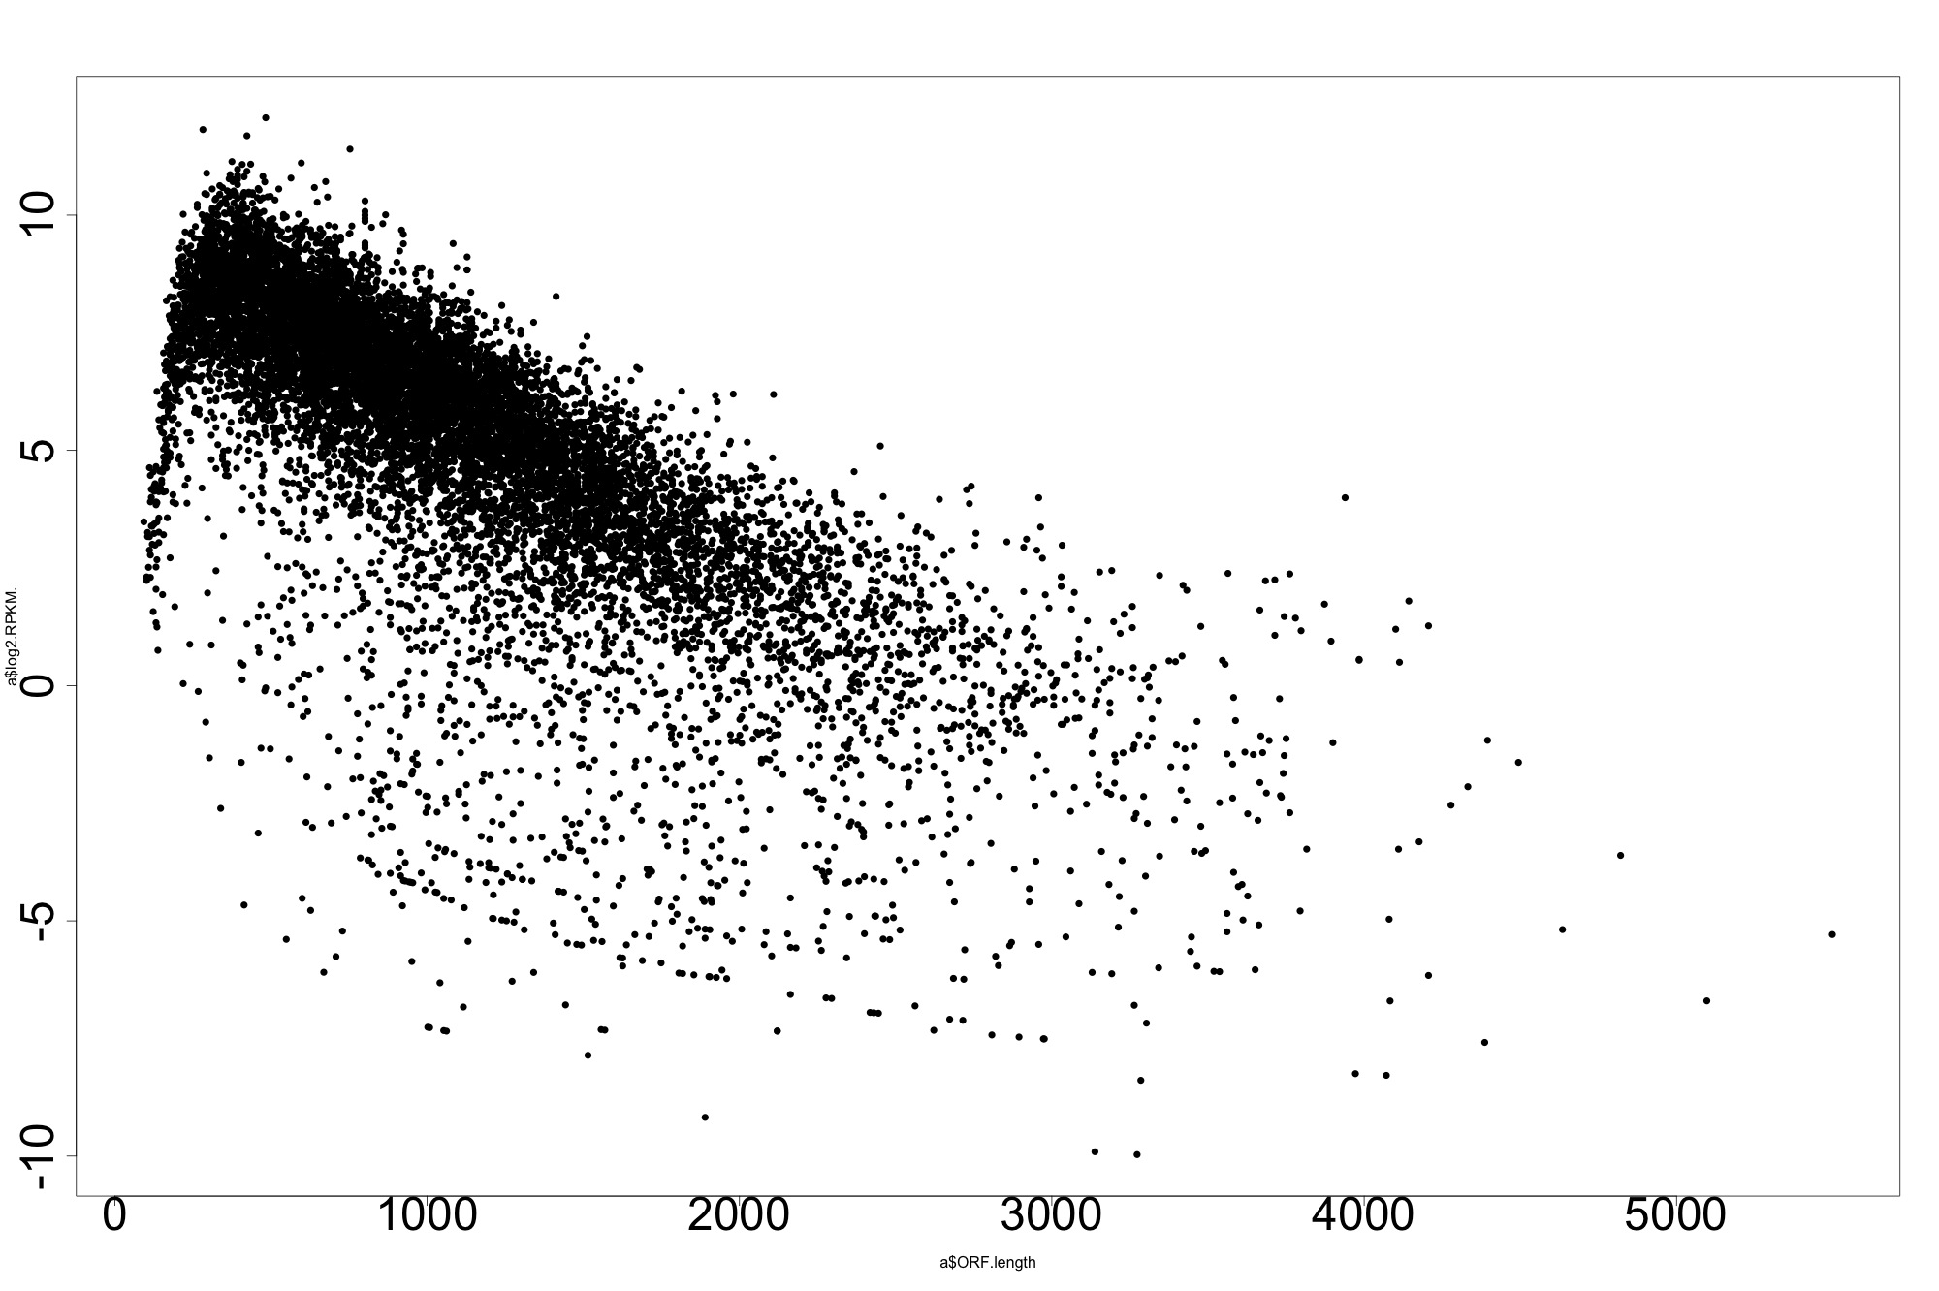
ORF RPKM (log scale)
ORF length (bp)
RPKM = Reads per kilo base per million
Additional File 6

