Slide 1
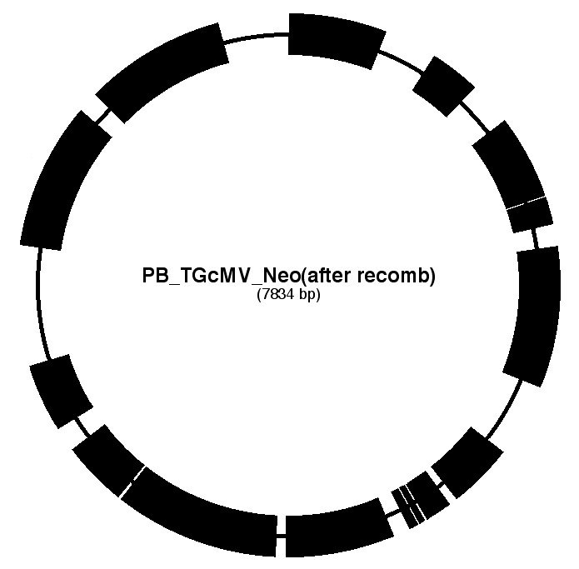
M13 ori
AmpR
PB - 3’ LTR
ColE1 ori
TREt
attR1
PB-TGcMV-Neo
CmR
PB - 5’ LTR
c-Myc
polyA
V5
ccdB
attR2
NeoR
PGK promoter
Additional File 7

