Slide 1
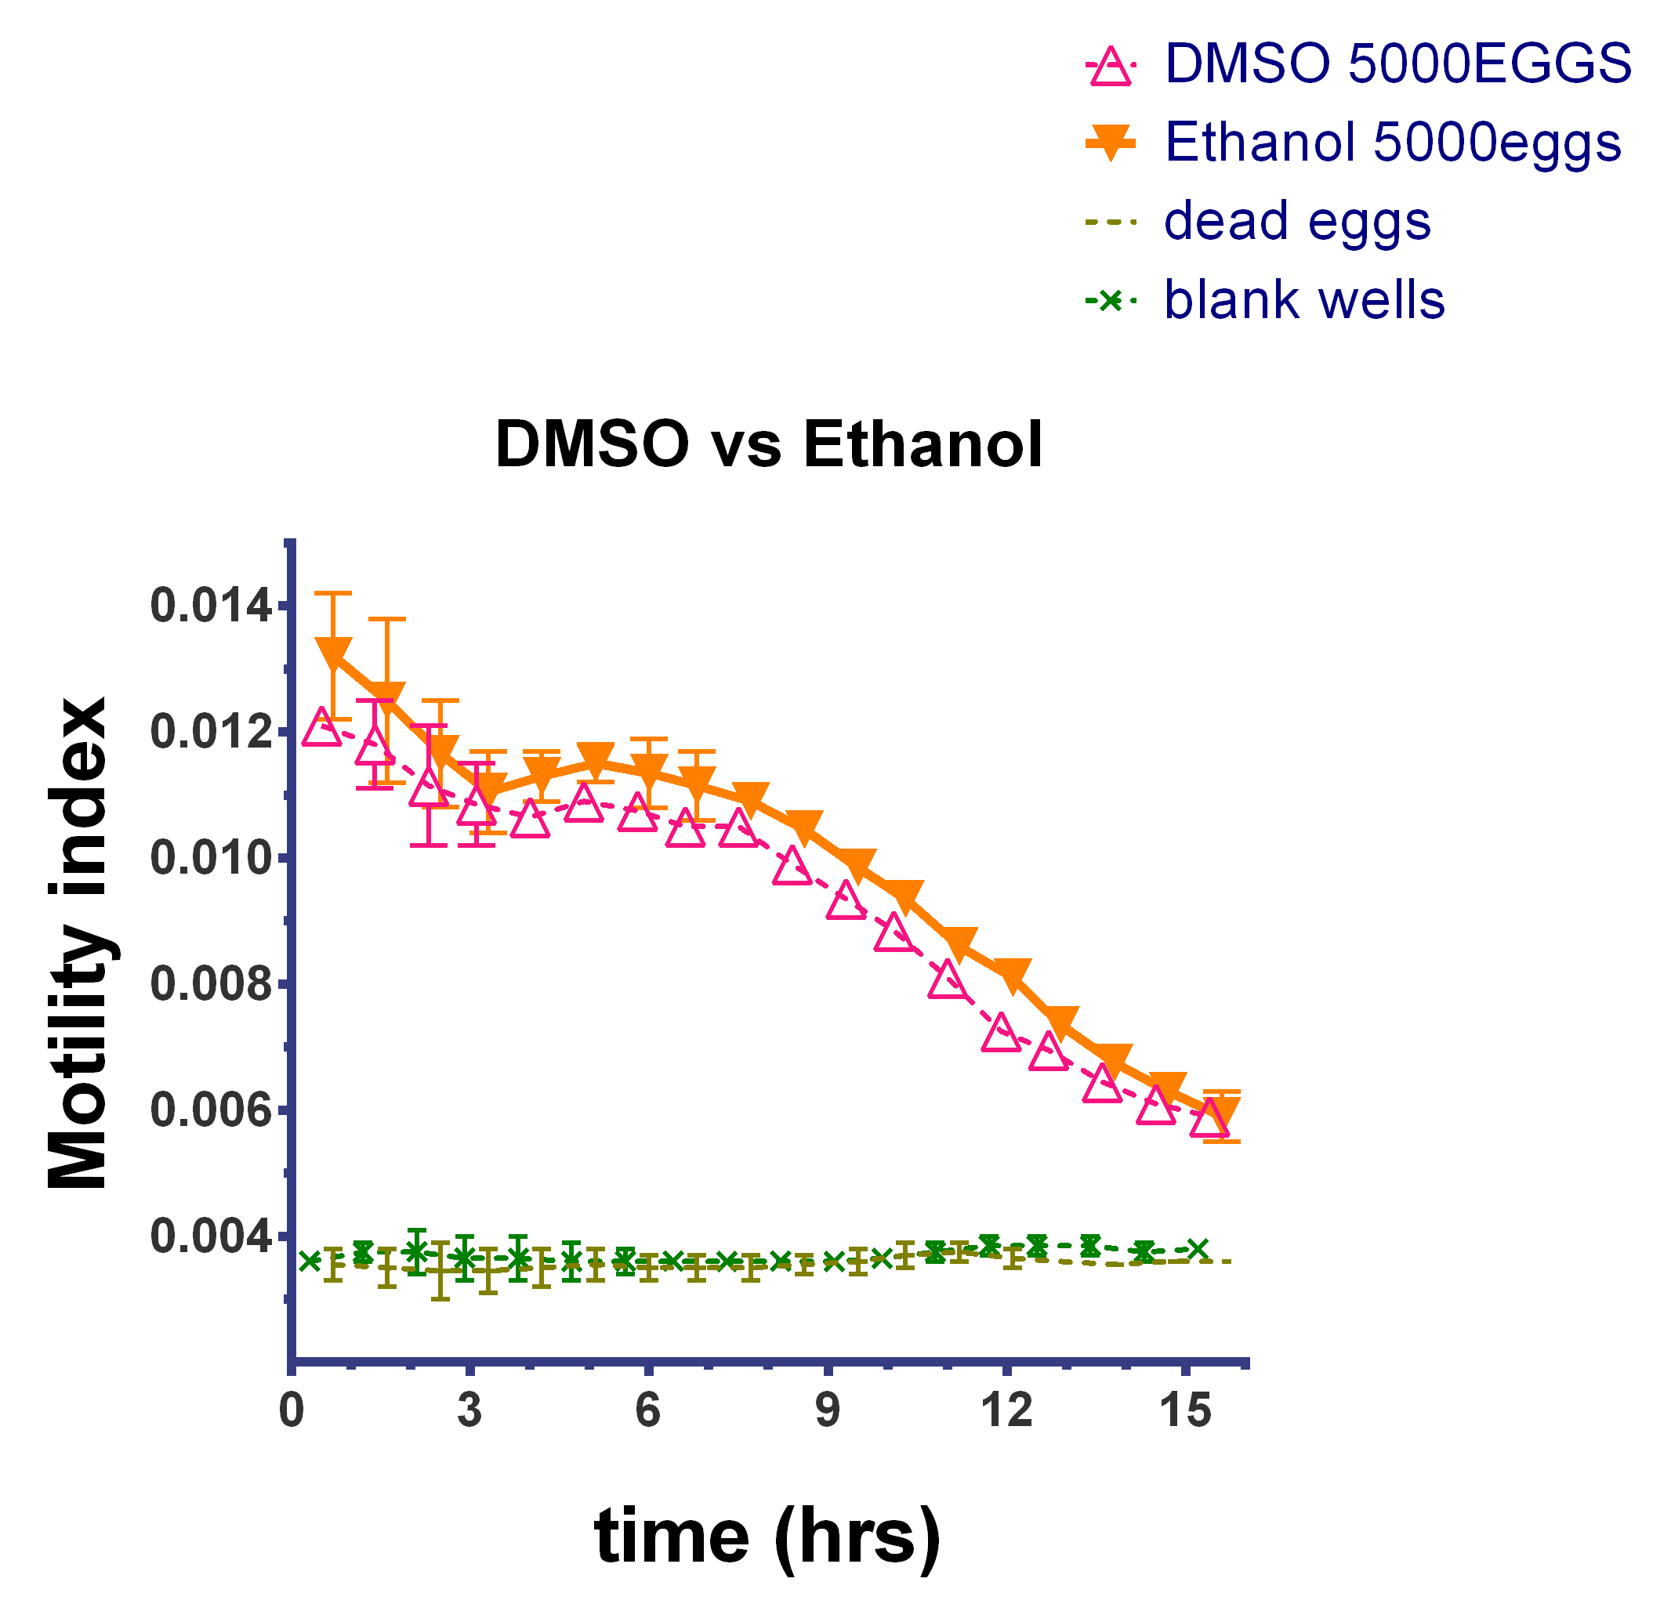
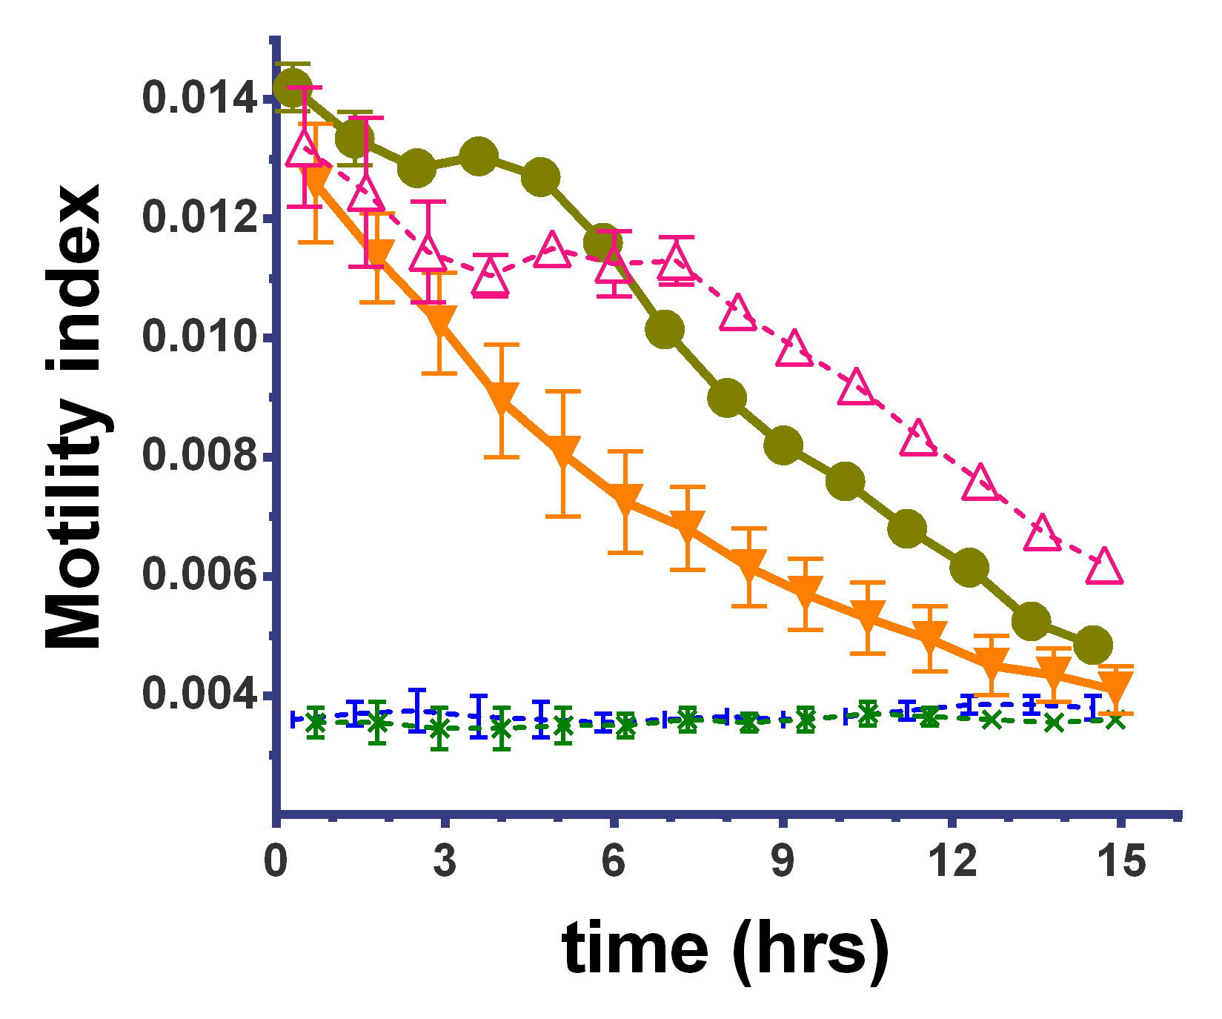
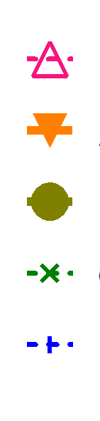
A
Vehicle control (DMSO)
Vehicle control (ethanol)
Heat killed eggs control
Empty well control
Time post-treatment (h)
Vehicle control (ethanol)
200 µM FCF
50 µM FCF
Heat killed eggs control
Empty well control
B
Time post-treatment (h)
Notes:
Panel A: Comparisons of egg hatch motility index with differing solvents (DMSO and ethanol alone) for FCF.
Panel B: Motility Index of miracidia hatching from the eggs exposed to light in 0.1x PBS in the absence or presence of indicated concentrations of FCF prepared in ethanol

