Slide 1
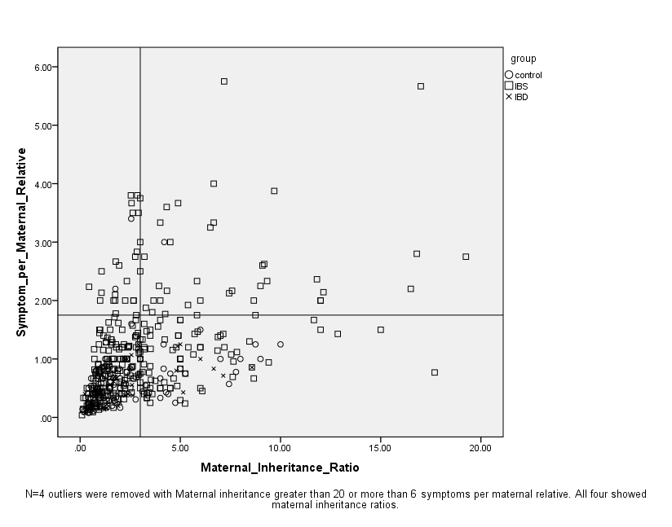
Probable Maternal Inheritance

