Slide 1
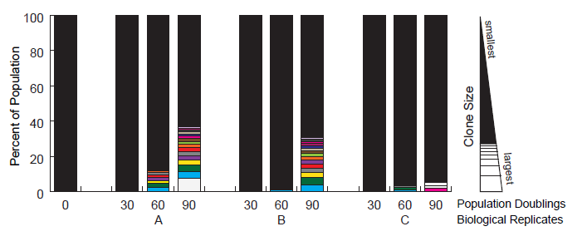
Additional File 3. Tracking major K562 clones in all populations.
Major clones are indicated by color, and that clone’s position (based on size, ranked largest to smallest from top to bottom) in other samples/timepoints is indicated by shapes in the same color.

