Slide 1

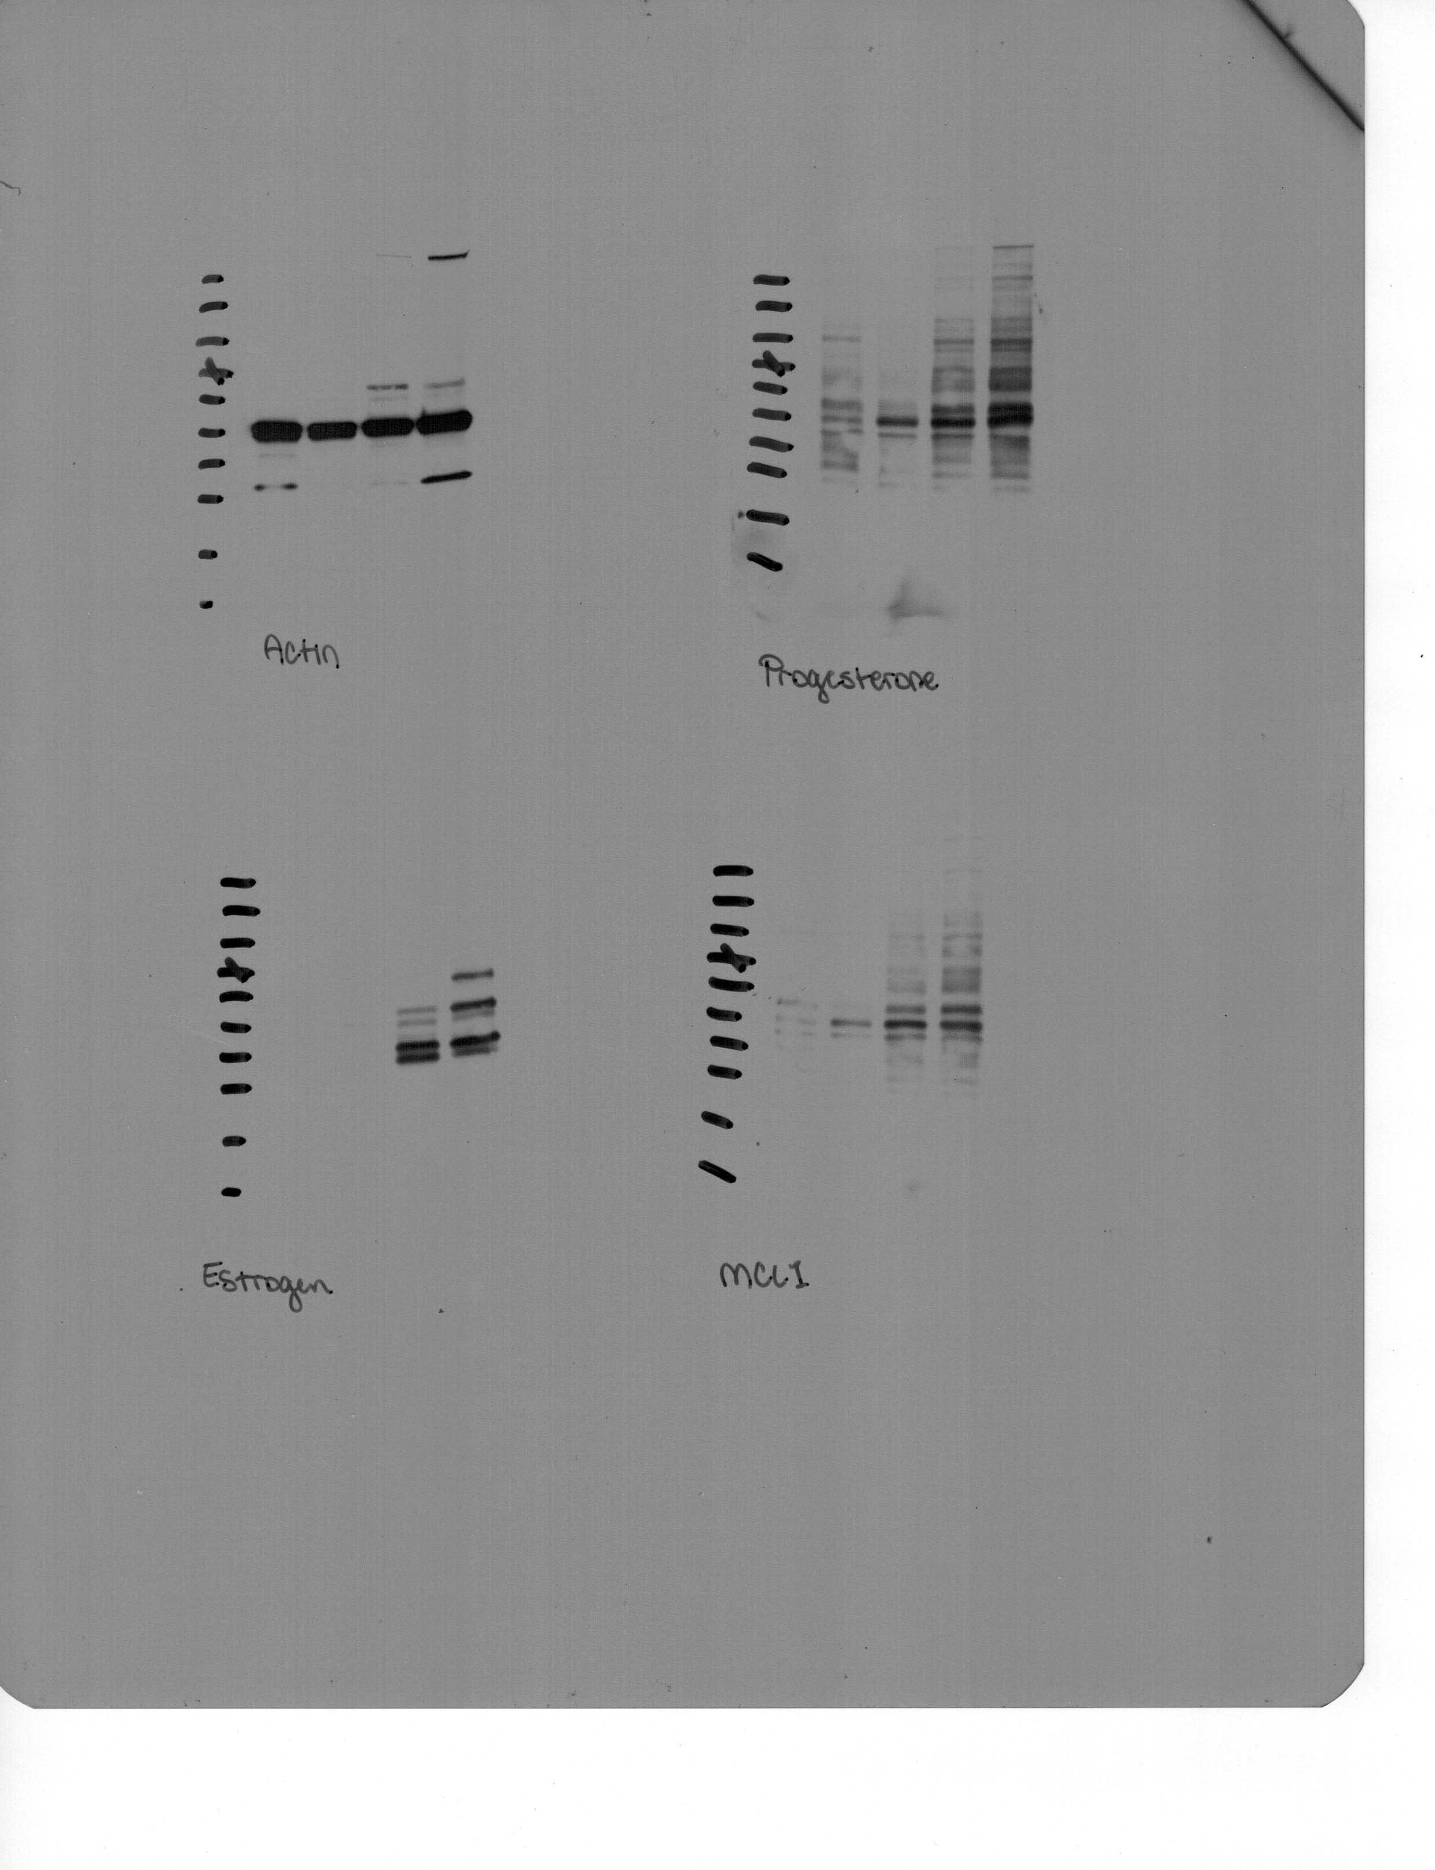
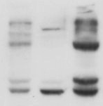
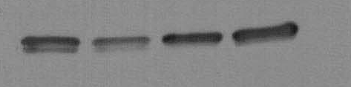
Figure S1
A
231
SKBr3
Mcf-7
ZR75
B
Progesterone Receptor
-130 kda
Estrogen Receptor
-100 kda
-70 kda
Progesterone receptor
Actin
-55 kda
Mcl-1
-35 kda
Actin
MCF-7

Slide 2
Figure S2
Fold increase
Fold increase
MDA-MB 231 cells
SKBr3 cells

Slide 3
Figure S3
Fold increase in luciferase activity

Slide 4
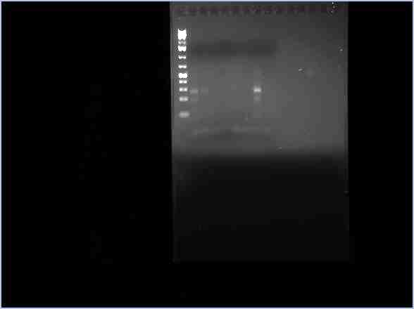
Supplemental Figure S4
Input
positive control for ChIP
Negative control for ChIP
No treatment
E2 treatment, 6 hours
No template control
+ | - | - | - | - | + | -
- | + | - | - | - | - | -
- | - | + | - | - | - | -
- | - | - | + | - | - | -
- | - | - | - | + | - | -
- | - | - | - | - | - | +

Slide 5
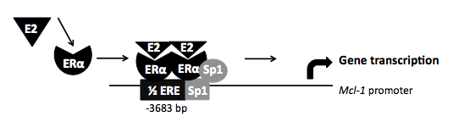
Supplemental Figure S5
Notes:
Figure 12

