Slide 1
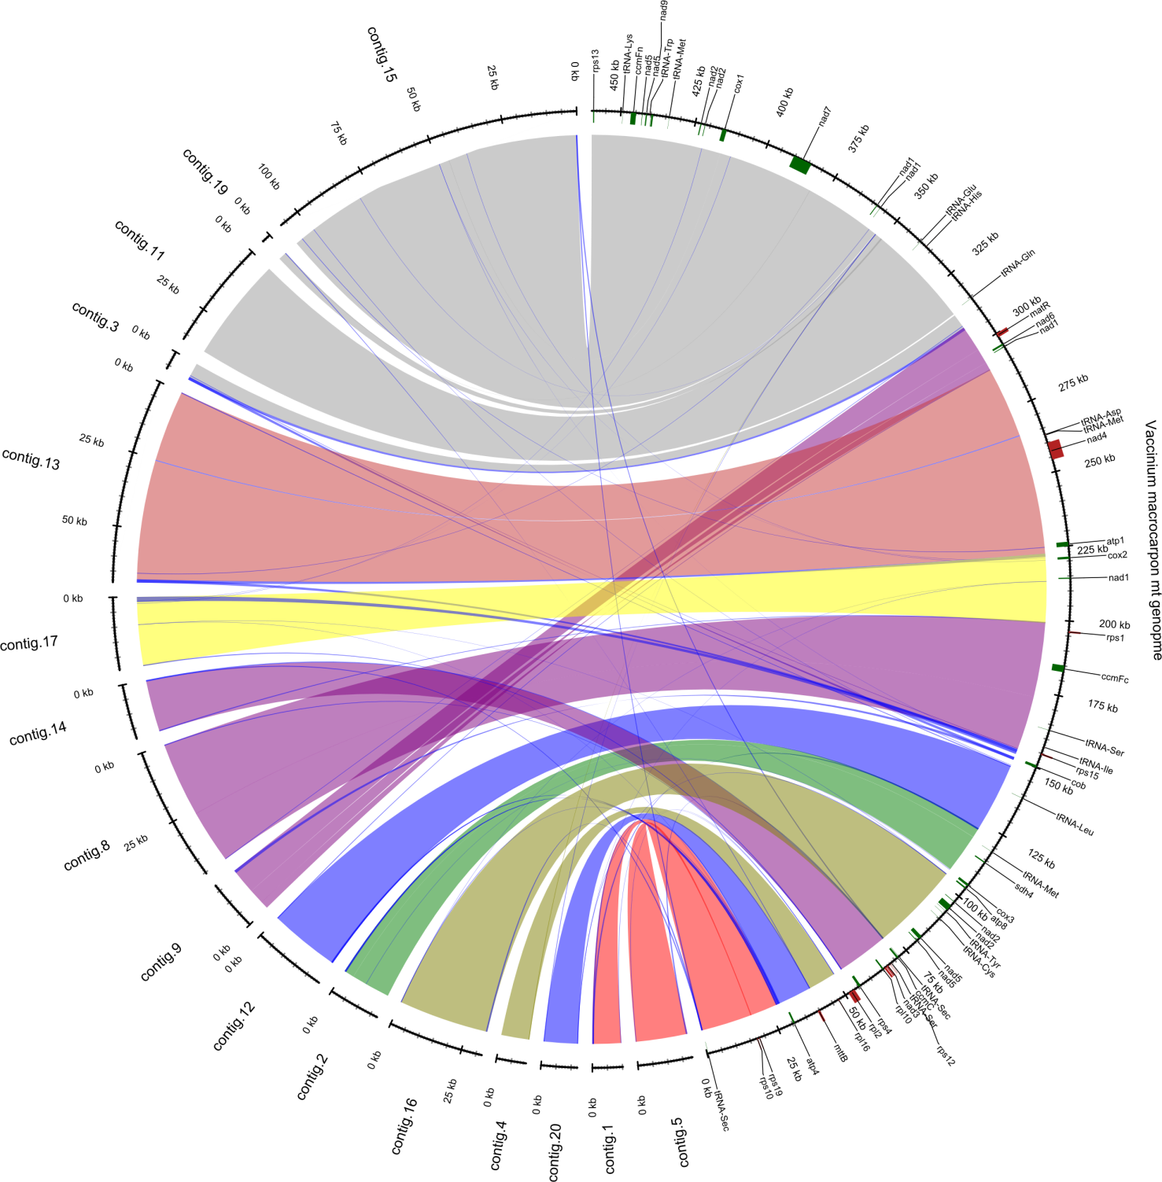
Supplementary Figure 1 – Mapped contigs from reassembled paired end reads to the cranberry
mitochondrial genome

