Slide 1
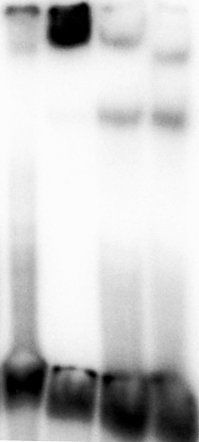
Supplementary Figure 1
- | 1.7 | 0.1 | 0.1
1.7 | 1.7 | 1.7 | 0.5
SsoRal1 (µM)
SsoRadA (µM)
SsoRadA
SsoRal1
ssDNA
1
2
3
4

