Slide 1
Supplemental Figure 1. Alignment of SnRK1.1, SnRK1.1T and SnRK1.2 amino acid sequences.
L

Slide 2
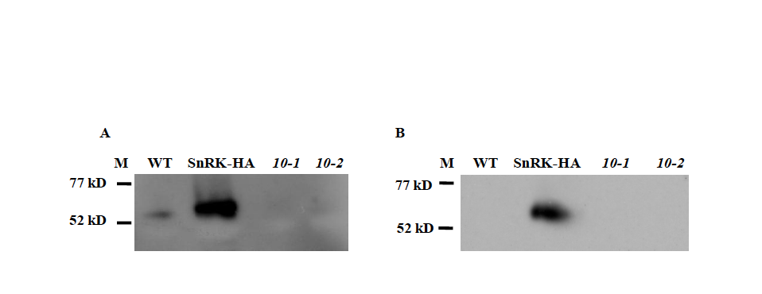
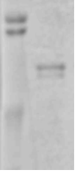
Supplemental Figure 2. Anti-SnRK1 Antibody and SnRK1 Activity Assays
M WT 1.1T-HA 10-1 10-2
A
108 kD
97 kD
54 kD
B
C
D
M WT 1.1T-HA 10-1 10-2

Slide 3
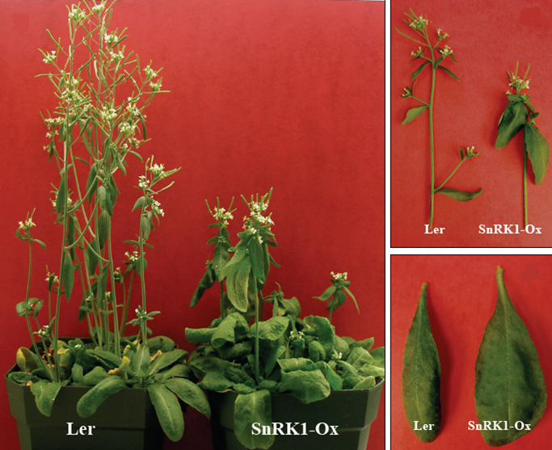
Supplemental Figure 3. Overexpression of SnRK1.1 in Landsberg erecta.

Slide 4
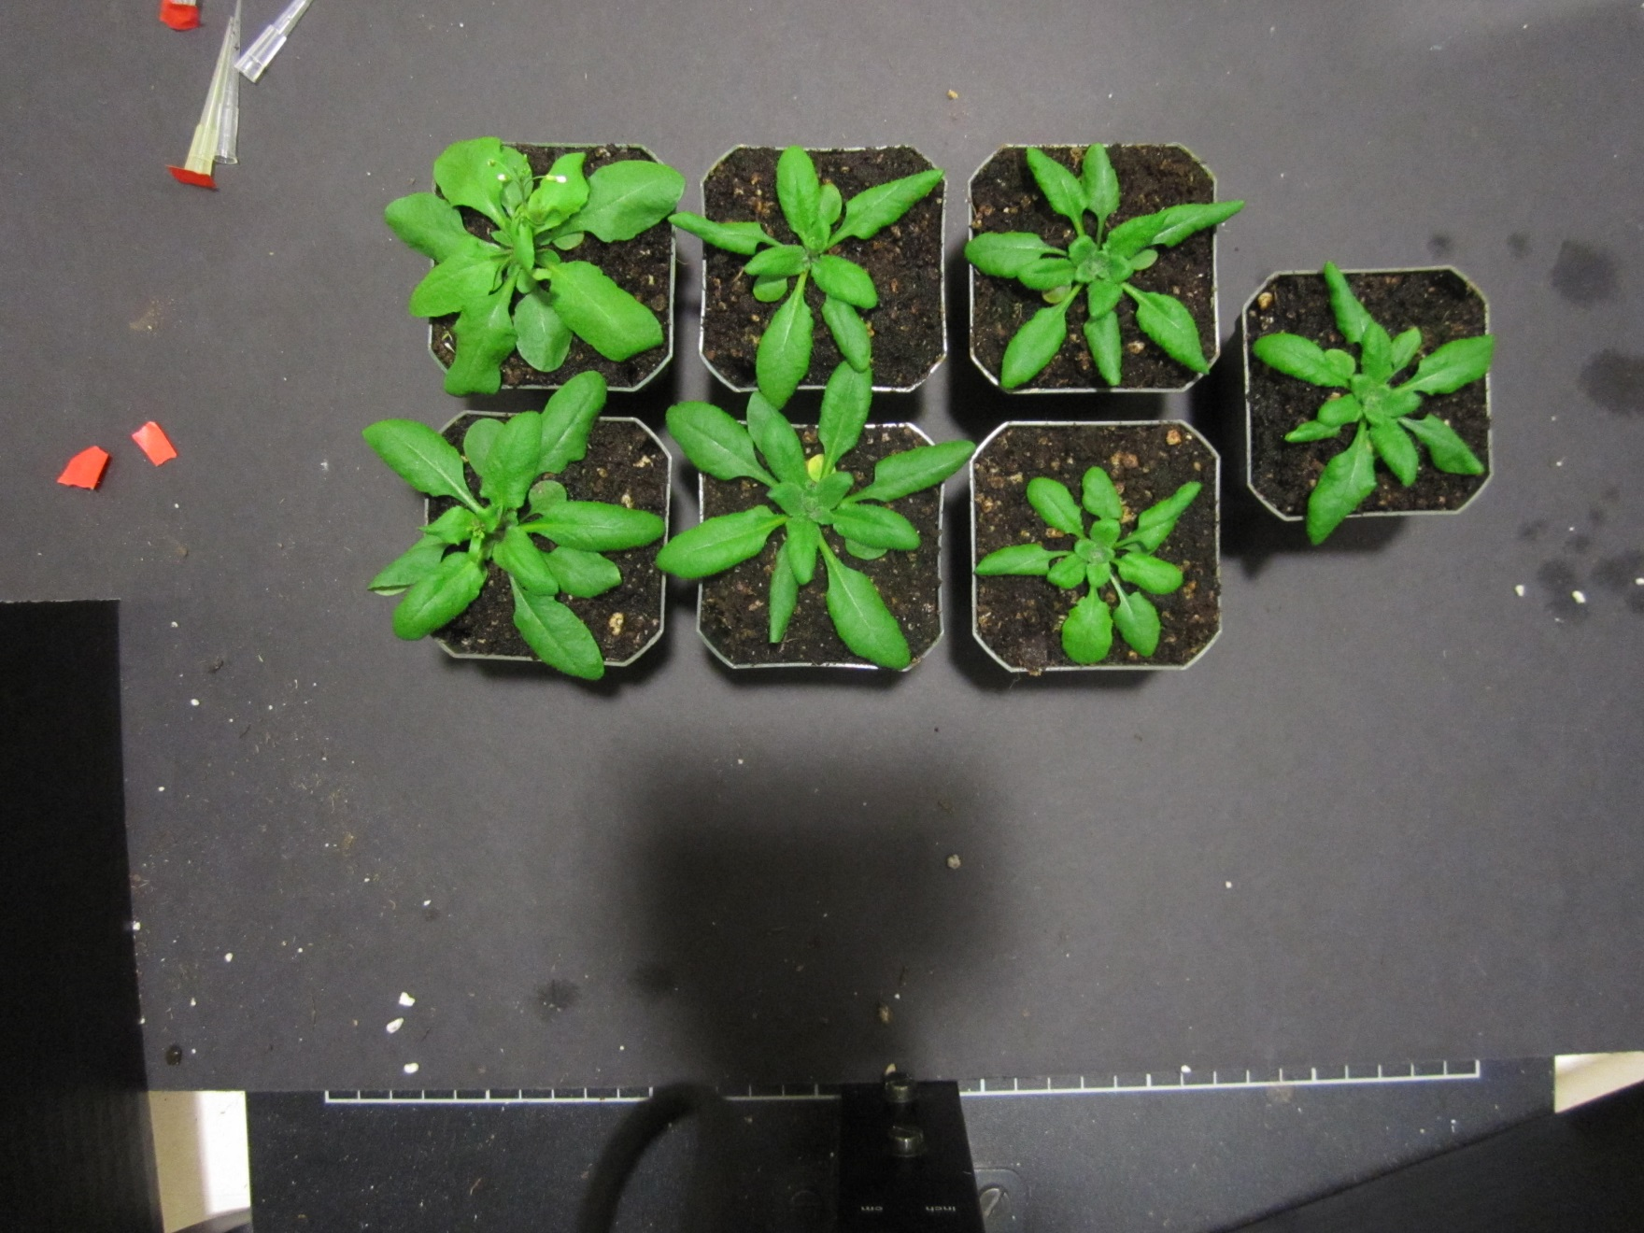
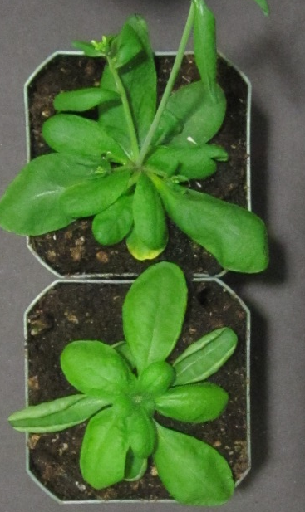
Supplemental Figure 4.
A
1.1a
1.1Ta
1.2a
Ler
WT
1.1b
1.1Tb
1.2b
1.1T-HA
B
*
*
*
*
*
*
*

Slide 5
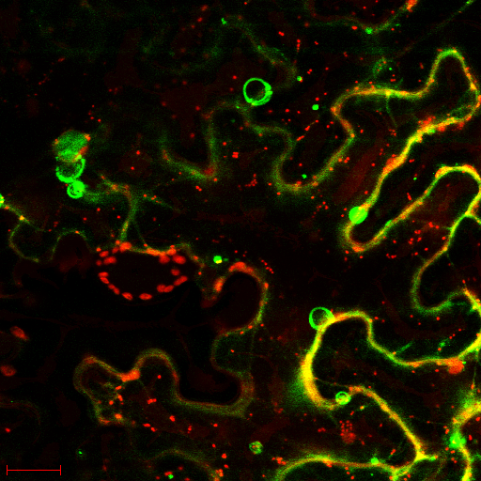
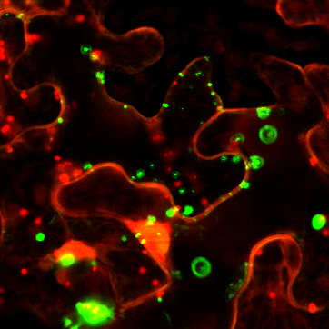
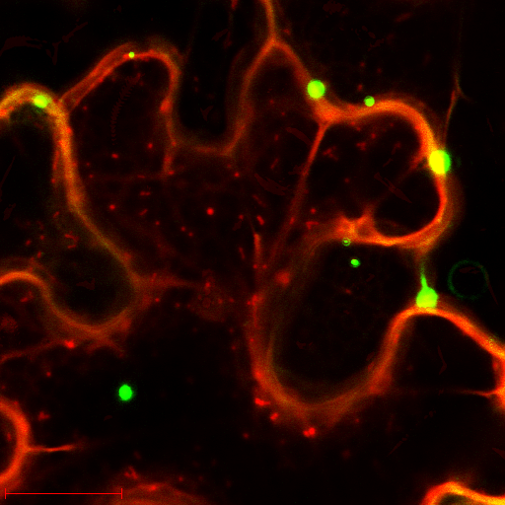
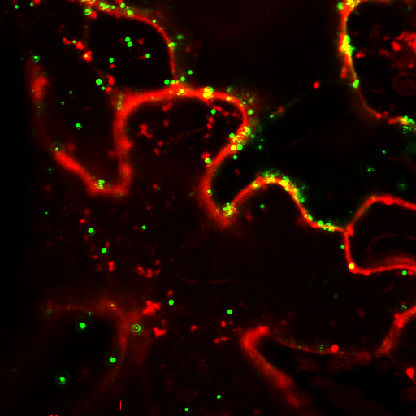
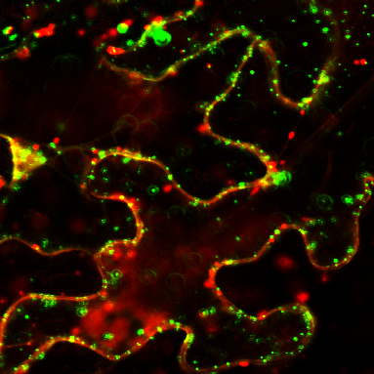
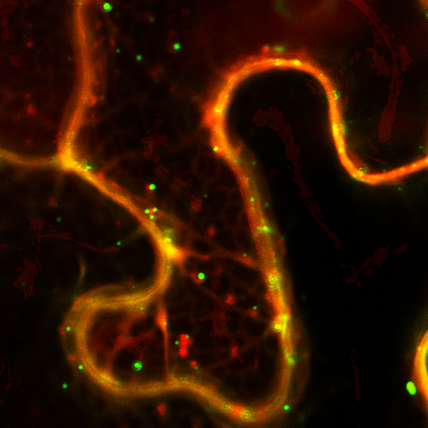
Supplemental Figure 5.
A
B
C
D
E
F

Slide 6
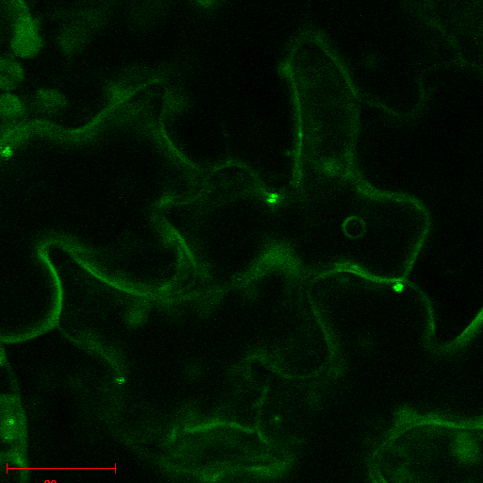
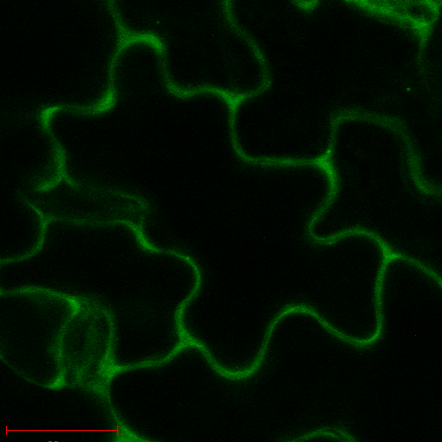
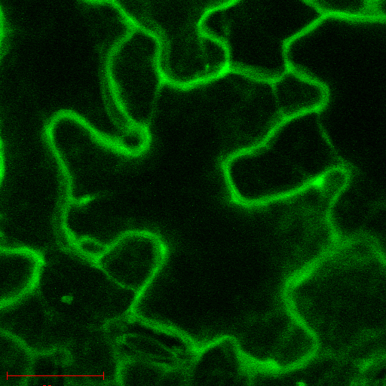
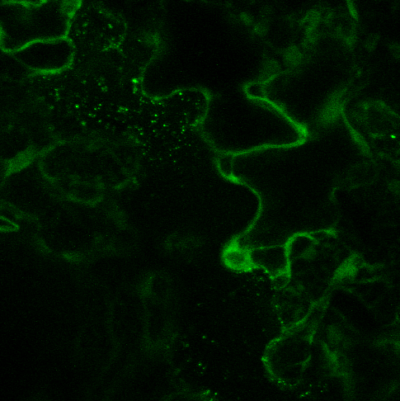
Supplemental Figure 6
B
1.1s3
A
B
E
C
D
E

