Slide 1
A. Coverage Statistics
B. Putative Tier 1 mutation counts
MOC line | SNVs | nsSNVs | Indels
1 | 2570 | 2069 | 48
22 | 3926 | 3111 | 61
23 | 4471 | 3566 | 52
2 | 677 | 534 | 25
2-10 | 637 | 498 | 18
Onken et al., Figure S1

Slide 2
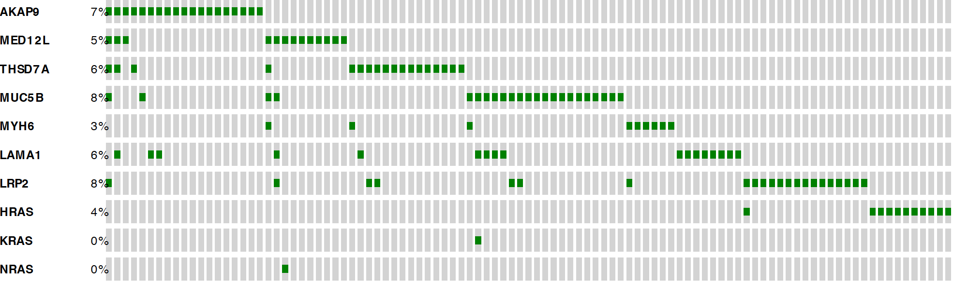
Onken et al., Figure S2

Slide 3
A. TCGA OSCC
B. TCGA OSCC
Smokers only
Number of SNVs
Onken et al., Figure S3

Slide 4
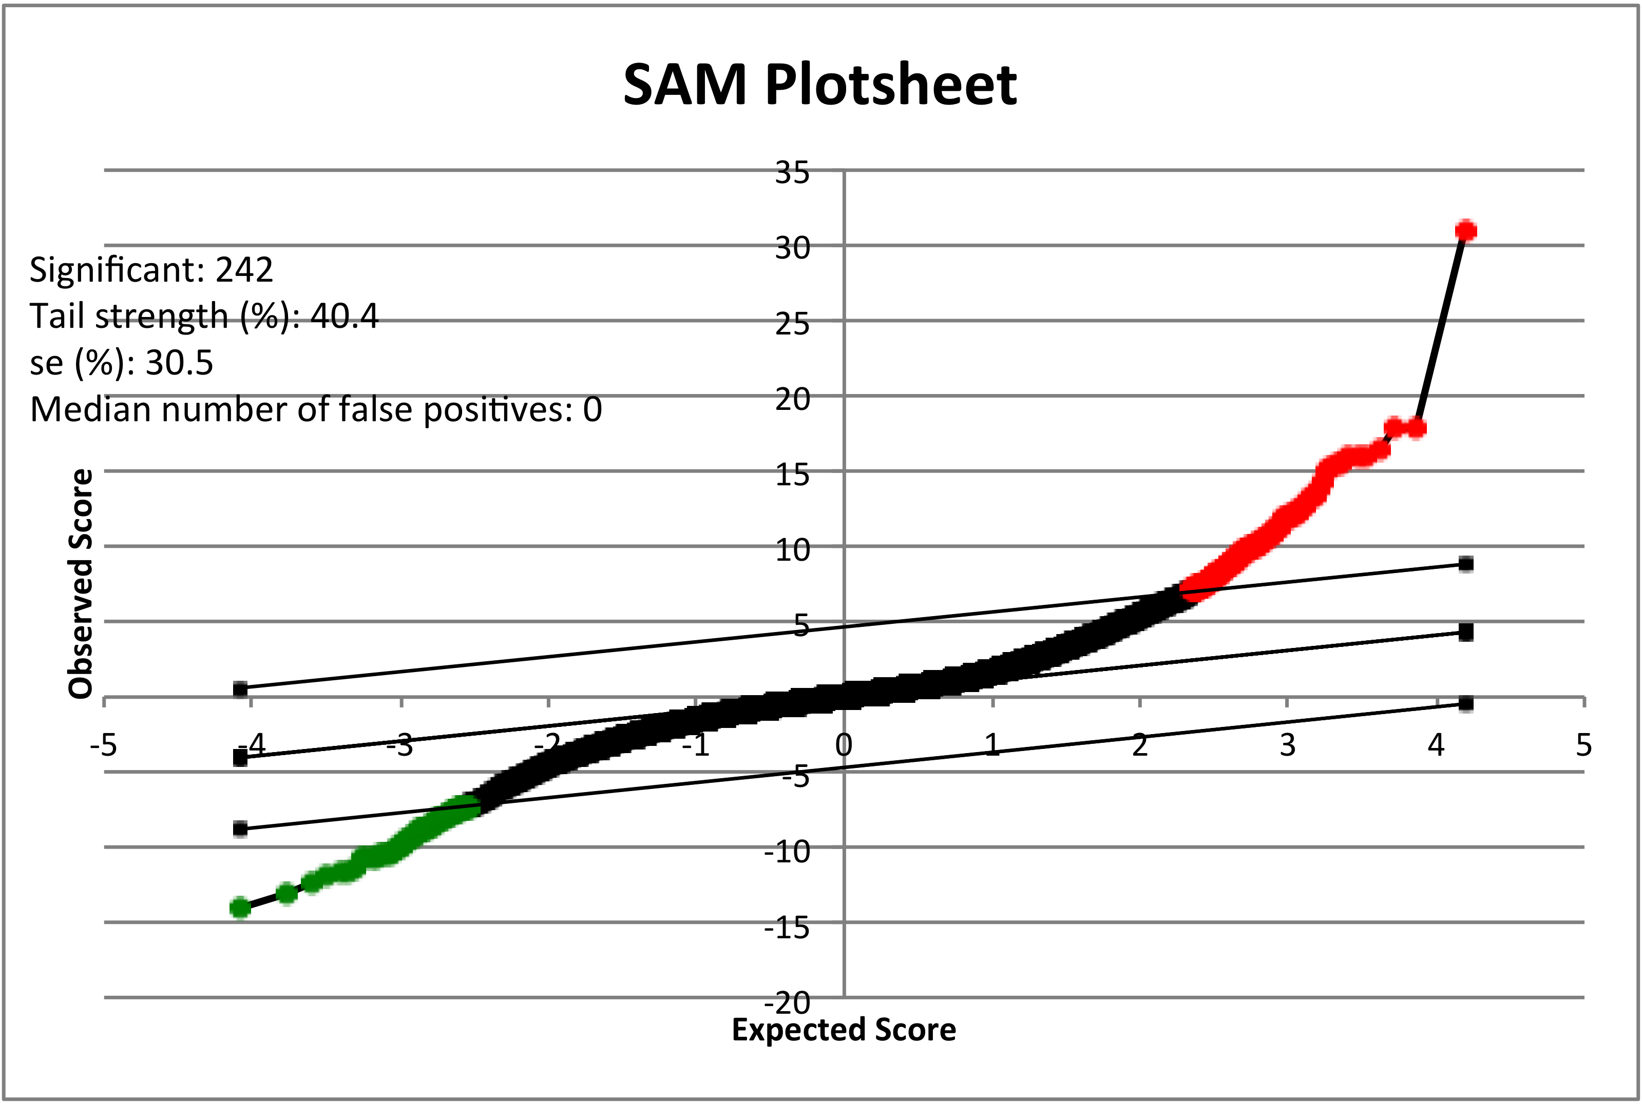
Onken et al., Figure S4

Slide 5
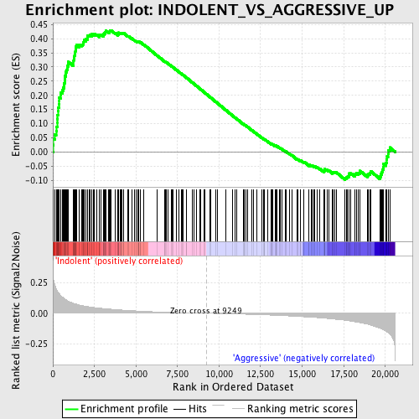
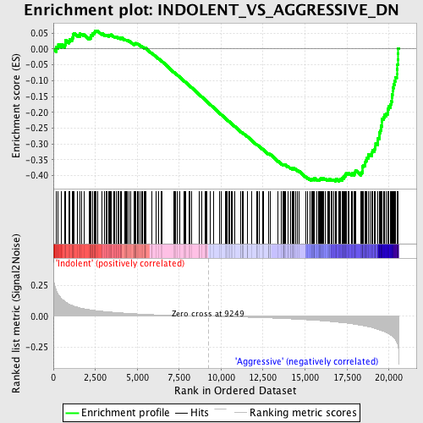
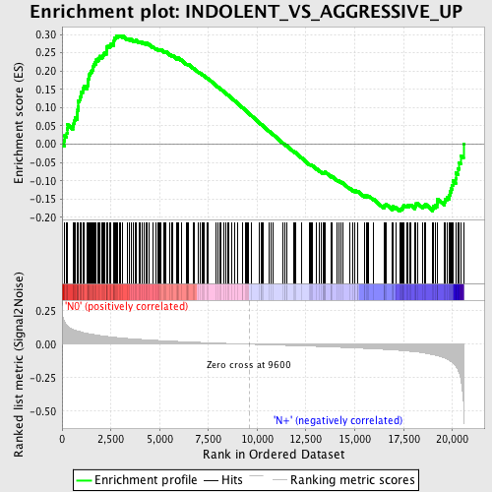
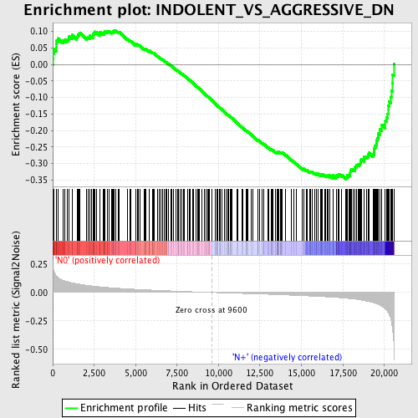
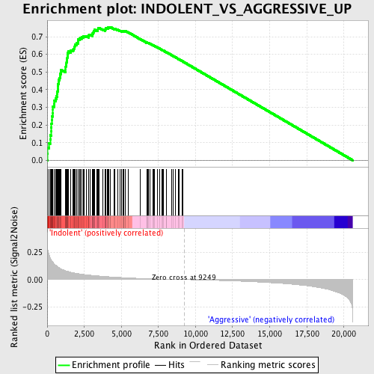
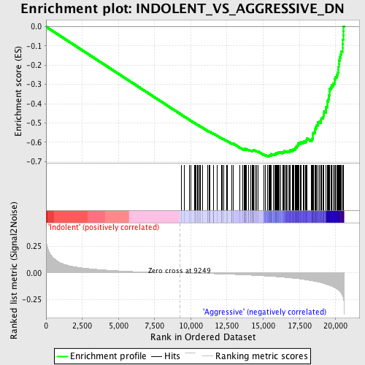
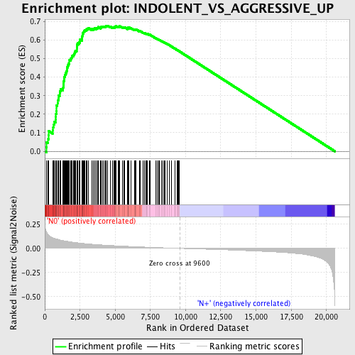
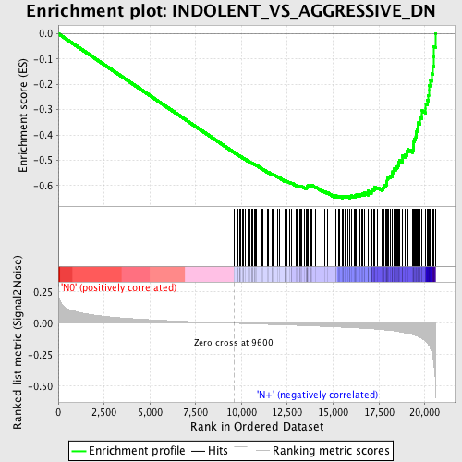
A. GSEA of OCAMP-A
on UW/FHCRC
C. GSEA of OCAMP-A on MD
B. 1st Trim OCAMP-A by
UW/FHCRC
D. 1st Trim OCAMP-A
by MD
Onken et al., Figure S5

Slide 6
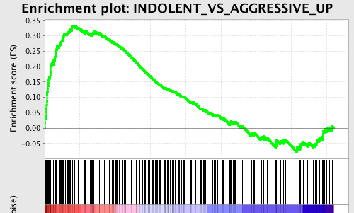
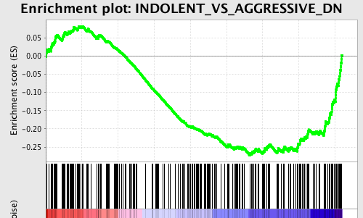
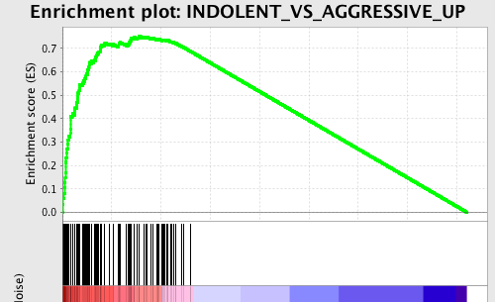
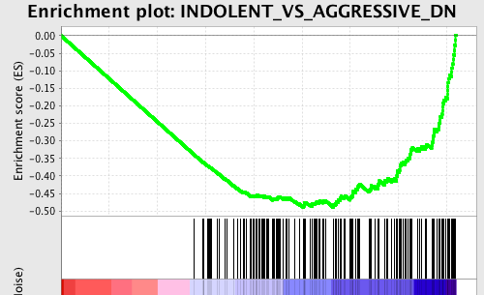
E. GSEA of OCAMP-A on TCGA
F. 1st Trim OCAMP-A by
TCGA
Onken et al., Figure S5, continued

Slide 7
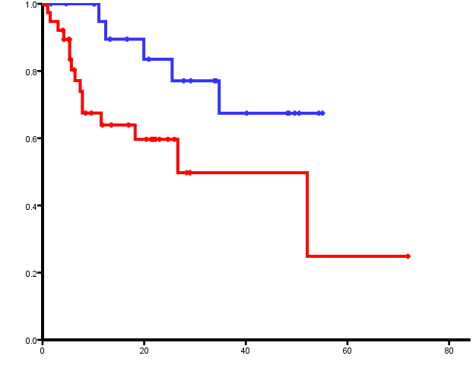
A. OCAMP-B DSS on MD
OCAMP-B low
Survival probability
OCAMP-B high
p=0.028
Time (months)
Onken et al., Figure S6

Slide 8
A. OCAMP-B DSS on UW/FHCRC
B. OCAMP-B OS on UW/FHCRC
p<0.01
p<0.01
Onken et al., Figure S7

