Slide 1
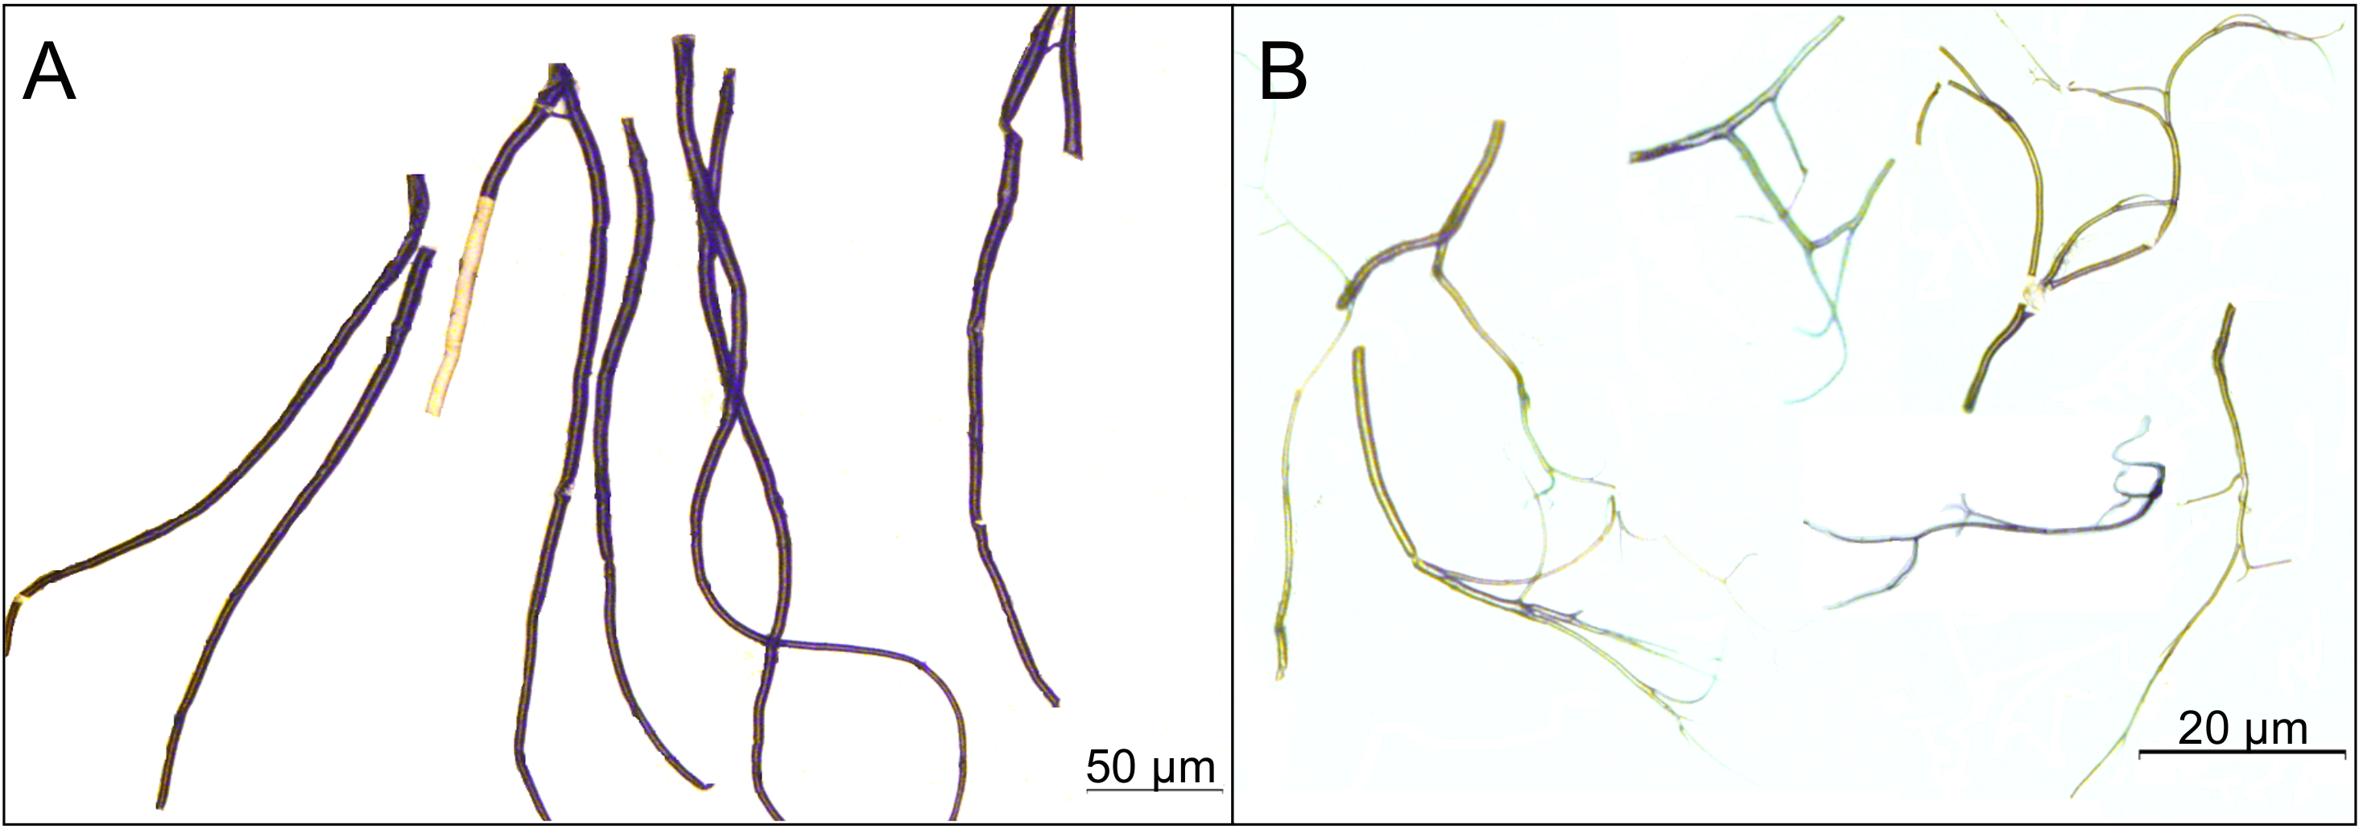
Figure S1
dorsal trunks
primary, secondary, terminal branches

