Slide 1
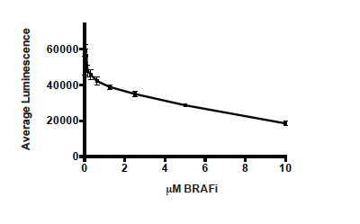
Supplementary Fig 1

Slide 2
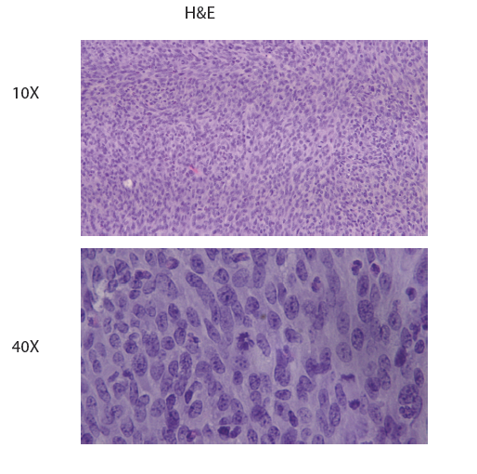
Supplementary Fig 2

Slide 3
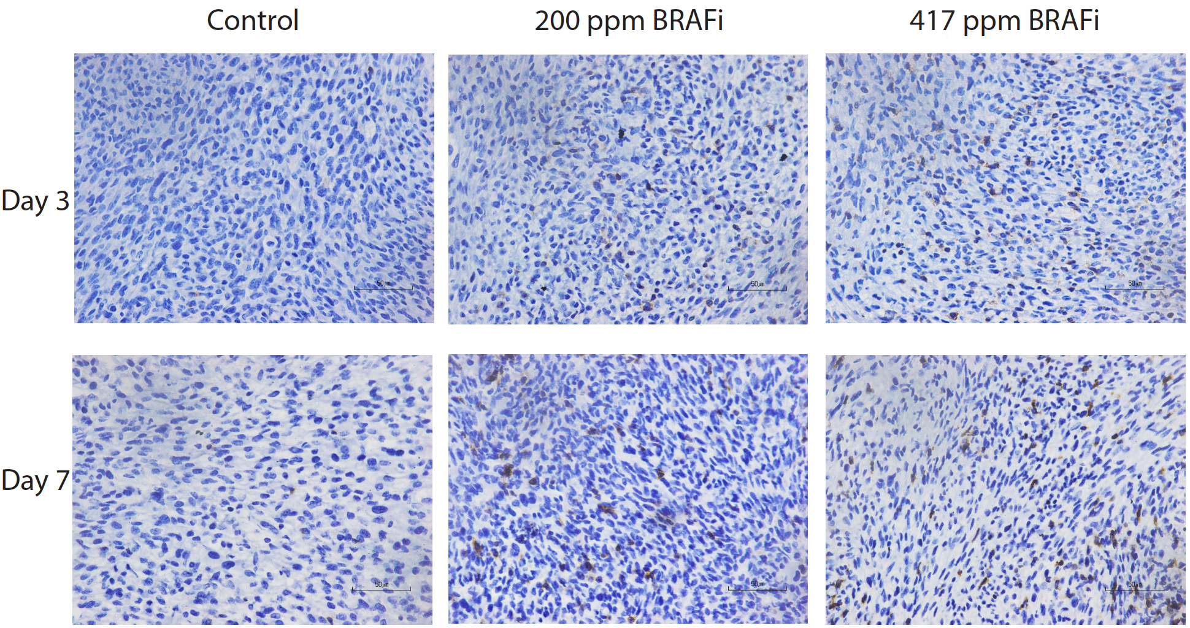
Supplementary Fig 3
IHC- CD3

Slide 4
Supplementary Fig 4

Slide 5
Supplementary Fig 5

Slide 6
Supplementary Fig 6

Slide 7
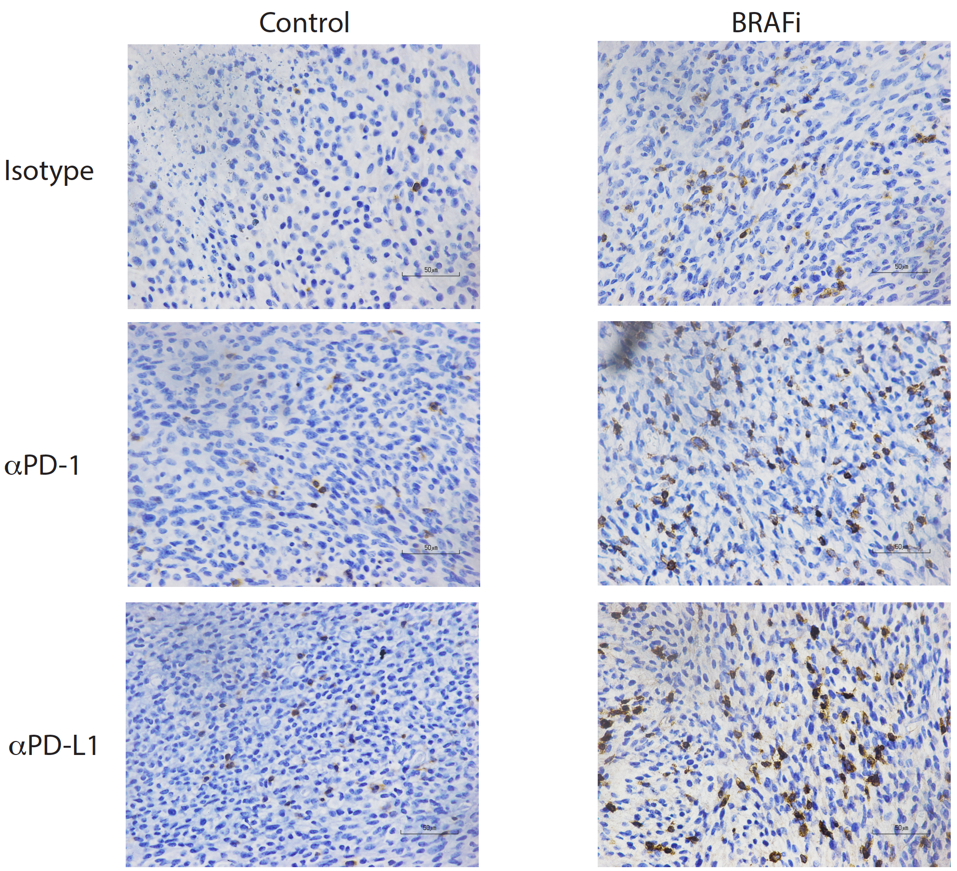
Supplementary Fig 7
IHC- CD3

