Slide 1
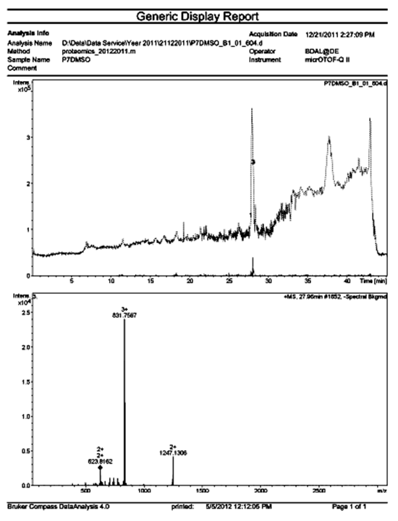
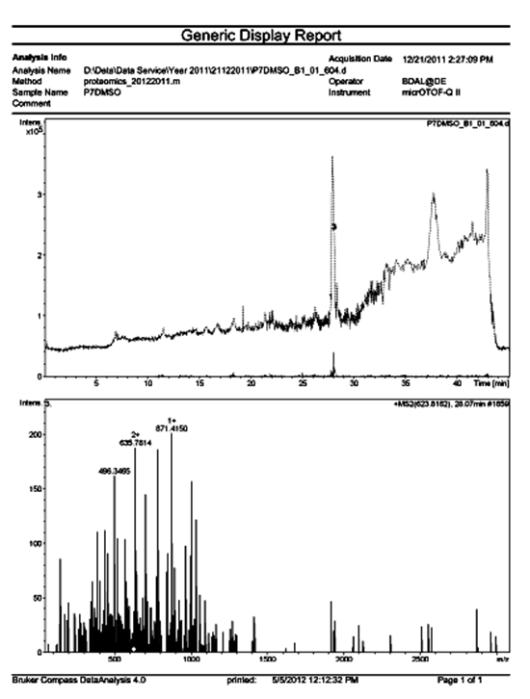
A
B
Figure S1
Sangphech et al., 2014

Slide 2
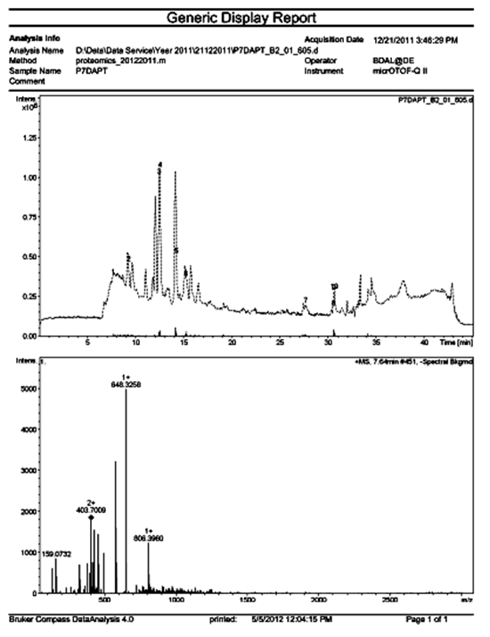
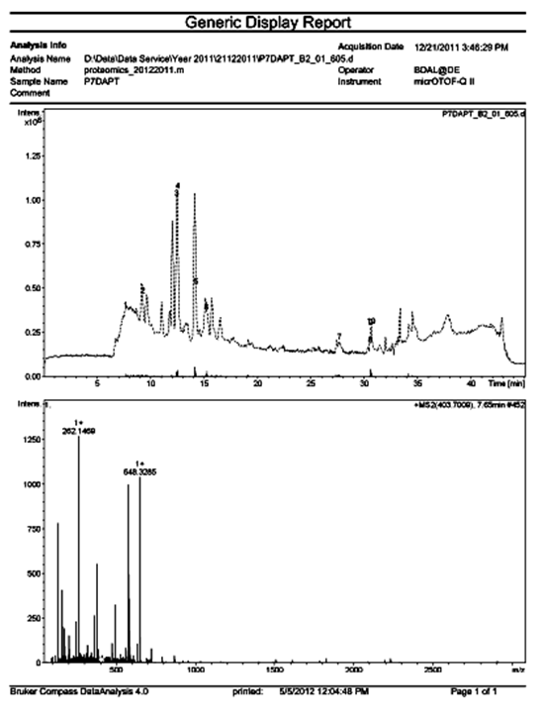
A
B
Figure S2
Sangphech et al., 2014

Slide 3
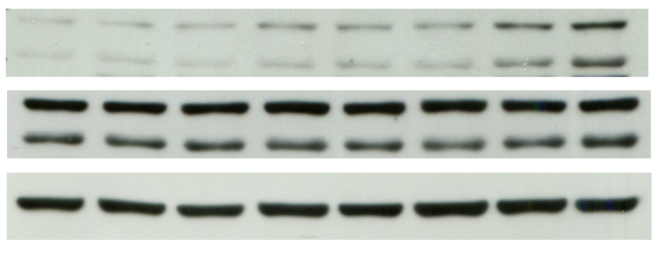
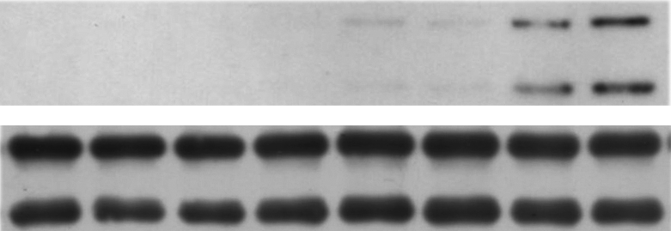
A
0 15 30 60
LPS (min)
- + - + - + - +
25 μM DAPT
Phospho-SAPK/JNK
Total-SAPK/JNK
β-actin
B
0 15 30 60
LPS (min)
+ - + - + - + -
AllStars
- + - + - + - +
siRGS19
Phospho-SAPK/JNK
Total-SAPK/JNK
Figure S3
Sangphech et al., 2014

Slide 4
Figure S1 Analysis of spot P7 that was obtained from DMSO-pretreated, LPS-stimulated macrophages (P7DMSO) using HRESIMS (nano-LC-MS/MS).
After the significantly different phosphorylation spot was subjected to in-gel digestion, the digested peptides were identified using HRESIMS (A) The MS spectrum of spot P7DMSO. (B) The HRESIMS spectrum of spot P7DMSO.
Figure S2 Analysis of spot P7 obtained from DAPT pretreated, LPS-stimulated macrophages (P7DAPT) using HRESIMS (nano-LC-MS/MS).
After the significantly different phosphorylation spot was subjected to in-gel digestion, the digested peptides were identified using HRESIMS (A) The MS spectrum of spot P7DAPT. (B) The HRESIMS spectrum of spot P7DAPT.
Figure S3 Effect of DAPT on SAPK/JNK phosphorylation in LPS-stimulated macrophages. The RAW264.7 cell line was pretreated with DAPT (25 mM) or vehicle control (DMSO) for 1 hr, and the cells were stimulated with LPS (100 ng/ml) for the indicated times. Phosphorylation of SAPK/JNK in cell lysates was detected using Western blotting.

