Slide 1
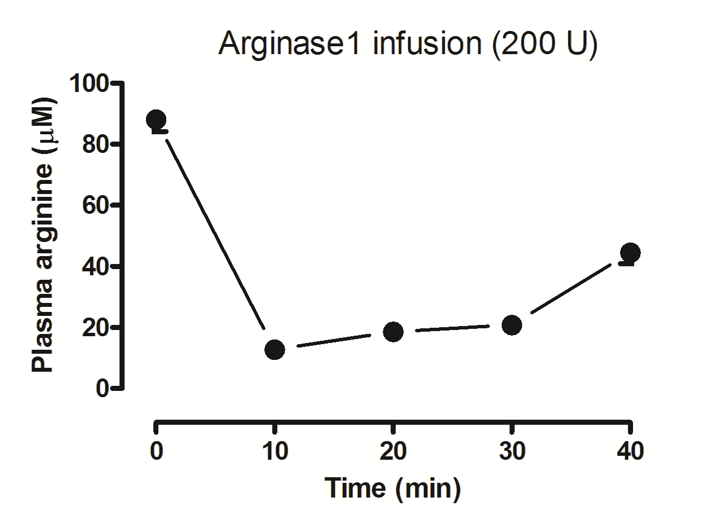
Figure S1
Notes:
PLEASE CHECK YOUR FIGURE AND TABLE NUMBERS TRHOUGHOUT THE TEXT!

