Slide 1
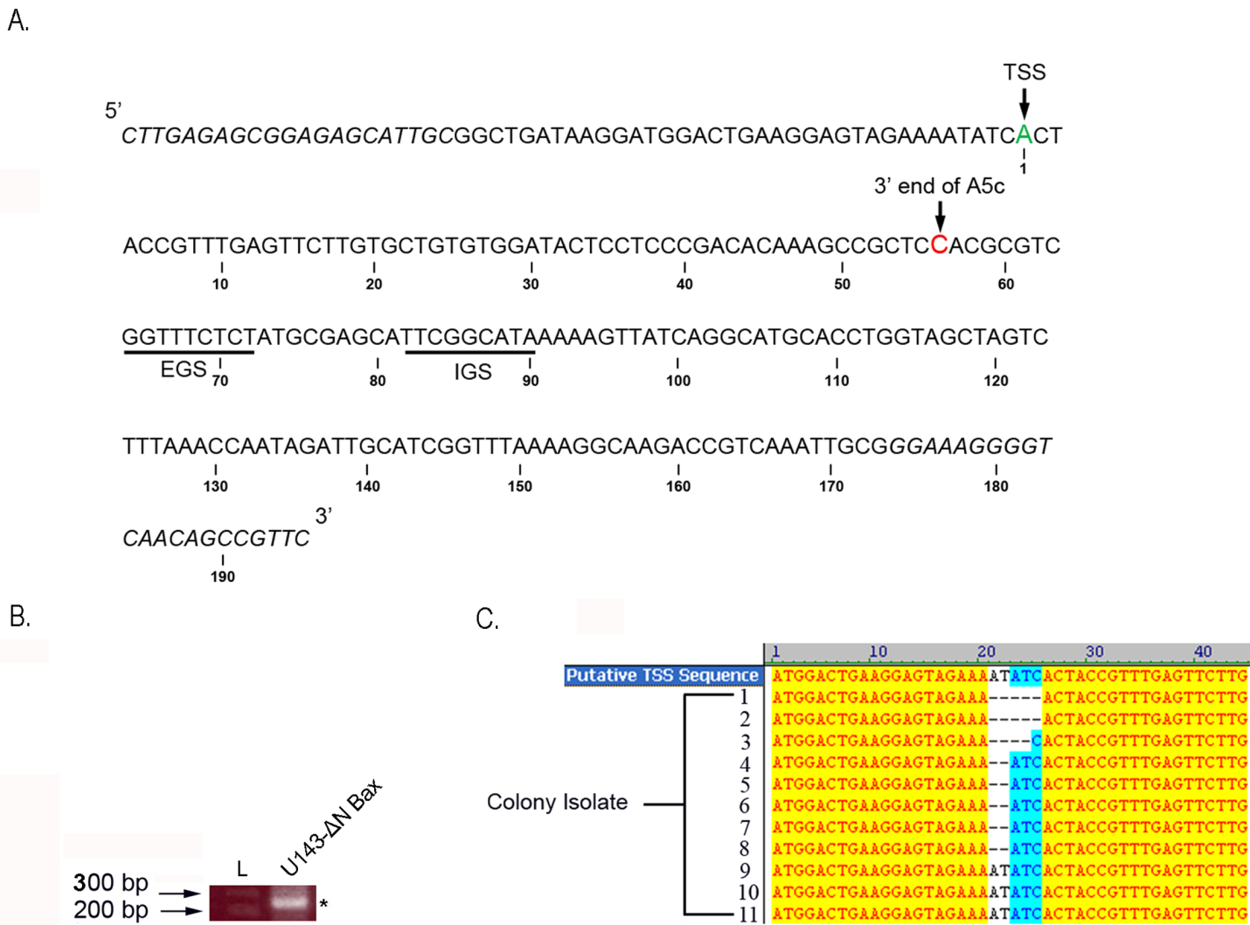
Supplemental Figure 1

