Slide 1
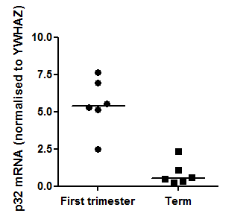
Supplementary Figure 3
**

