Slide 1
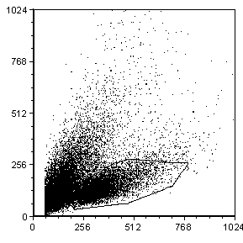
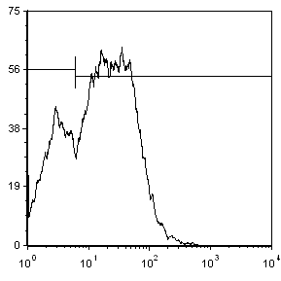
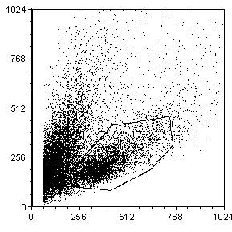
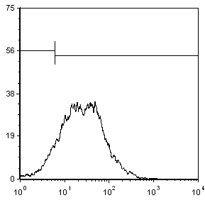
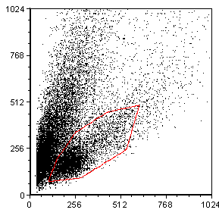
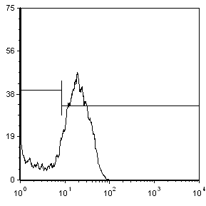
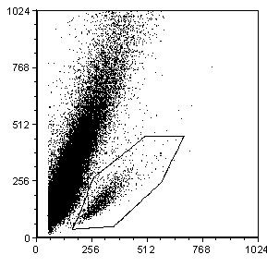
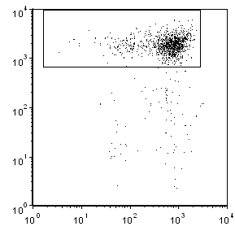
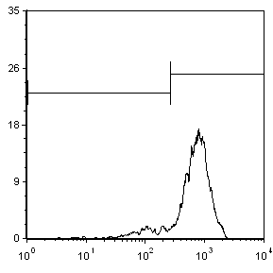
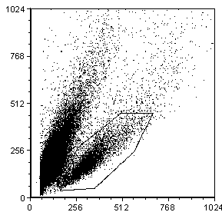
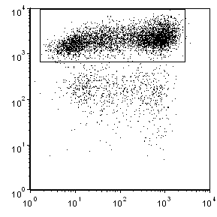
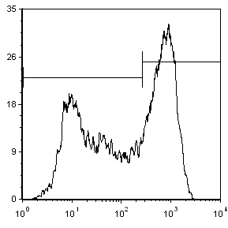
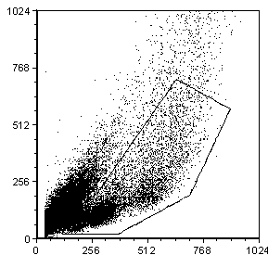
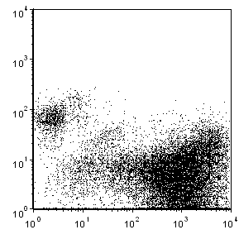
A.
B.
SSC-H
counts
SSC-H
counts
FSC-H
CAR-GD2
FSC-H
IL-7Rα
C.
SSC-H
counts
FSC-H
STAT5
D.
M1
Lymphocytes
SSC-H
CD8
counts
CD8 positive
FSC-H
CFSE
CFSE
CFSE dilution
SSC-H
CD8
counts
M1 based on non stimulated CTR
FSC-H
CFSE
CFSE
E.
SSC-H
CD3
FSC-H
GFP
Supplementary Fig. 1. Flow cytometry gating strategies. A. Gating strategy to evaluate the transduction efficiency for the CAR-GD2. The gate was drawn based on the physical parameters and the expression of the CAR-GD2 evaluated on gated cells. B. Gating strategy to evaluate the transduction efficiency for IL-7Rα. The gate was drawn based on the physical parameters and the expression of IL-7Rα evaluated on gated cells. C. Gating strategy to evaluate the phosphorylation of STAT5. The gate was drawn based on the physical parameters and the phosphorylation of STAT5 evaluated on gated cells. D. Gating strategy to assess CSFE dilution. After gating on lymphocyte, the dilution of the CFSE was assessed on CD8+ cells. Two independent experiments are shown. E. Gating strategy to assess the elimination of tumor cells in co-culture experiments. The gate was drawn based on the physical parameters. Lymphocytes were identified based on CD3 expression and tumor cells by GFP expression on gated cells.

