Slide 1
Supplementary Data
KIF5B-RET fusion kinase promotes cell growth by multilevel activation of STAT3 in lung cancer
Table S1. Clinicopathological data of patients with lung adenocarcinoma(n=100)
Factors |  | NO. of patients |  |  | KIF58-RET fusion
 |  |  |  |  | （＋）n=1 |  | （-）n=99
Age(years)
≤65 |  | 80 |  |  | 1 |  |  | 79
＞65 |  | 20 |  |  | 0 |  |  | 20
Gender
Male |  | 57 |  |  | 0 |  |  | 57
Female |  | 43 |  |  | 1 |  |  | 42
Smoking
Never smoker |  | 50 |  |  | 1 |  |  | 49
Smoker |  | 50 |  |  | 0 |  |  | 50
Stage
I-II |  | 53 |  |  | 1 |  |  | 52
III-IV |  | 47 |  |  | 0 |  |  | 47
Differentiation
Moderate-Well |  | 39 |  |  | 0 |  |  | 39
Poor |  | 61 |  |  | 1 |  |  | 60
Table S2. Clinicopathologic details of KIF5B-RET positive lung cancer patient
patient NO. | Age | smoking | Tumor Size | Lymph Node Status | Histology | Differentiation | Fusion Variant | IHC
 |  |  |  |  |  |  |  | RET | TTF-1 | Nap-A
NO.21 | 58y | never | 4cm | N0 | ADC | poor | K15;R12 | + | + | +

Slide 2
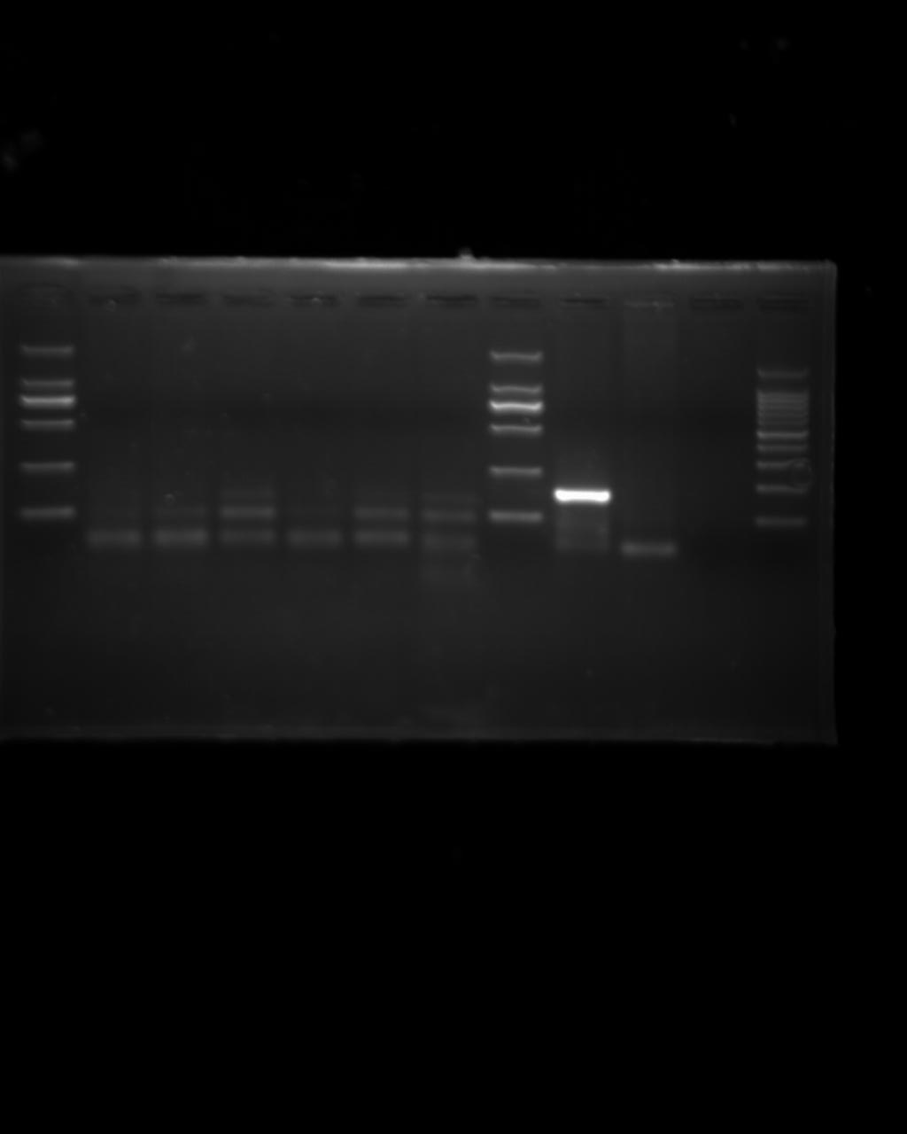
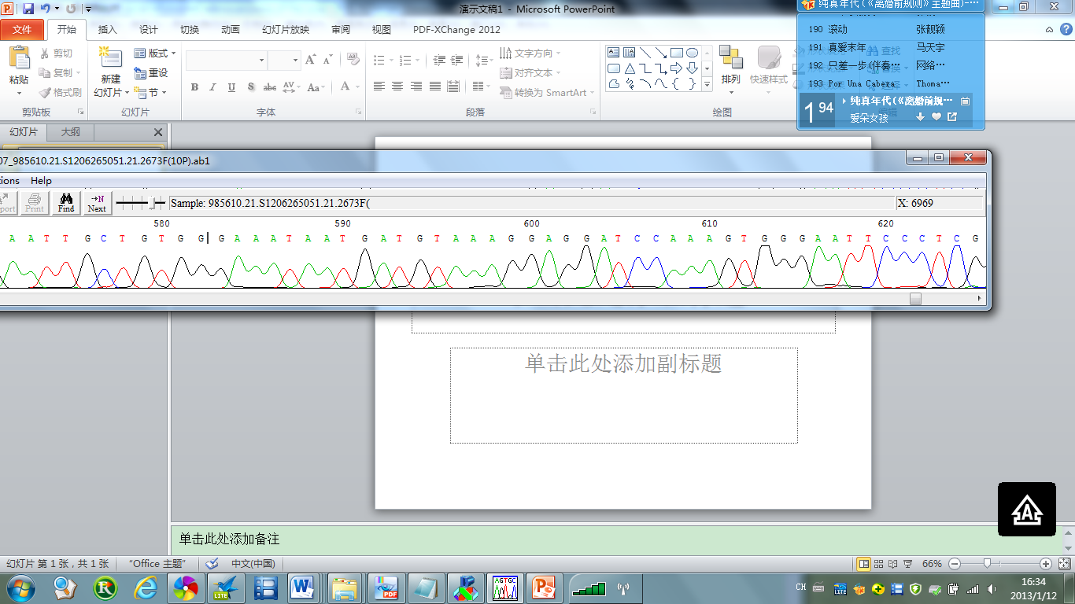
Figure S1 (related to Figure 1).
A.
B.
Marker 21# T 21#N
2000
1000
750
500
250
100
KIF5B exon 15
RET exon 12
Figure S1.
(A) Detection of KIF5B-RET fusion by RT-PCR analysis in NO.21 patient among 100 Chinese LAD patients. The KIF5B-RET fusion gene was detected by RT-PCR. One LAD positive for KIF5B-RET fusions (T) is shown, with its corresponding noncancerous lung tissues (N).
(B) KIF5B exon 15 fused to RET exon 12 (K15; R12) were validated by direct sequencing. The fusion point of KIF5B-RET is shown.

