Slide 1
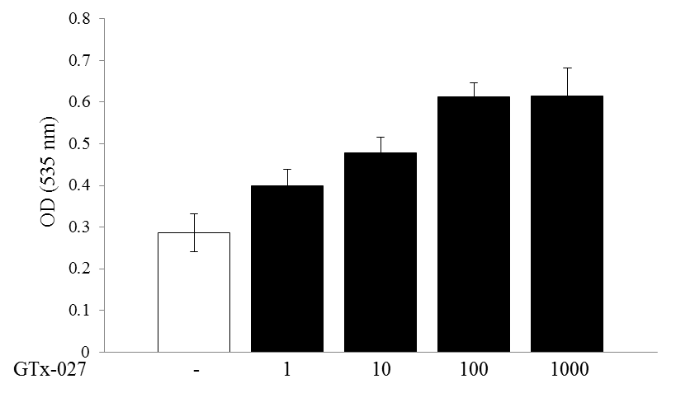
Figure S1
nM

