Slide 1
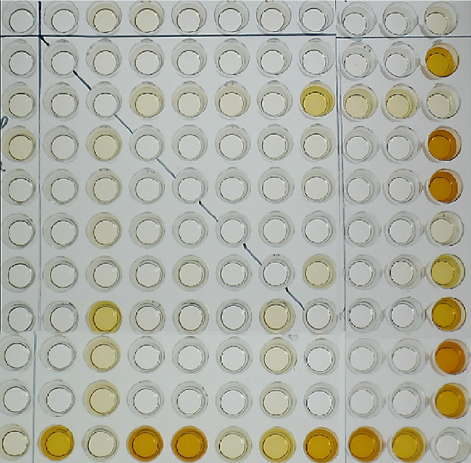
GaNAc- GD1a
GM1
GM1b
GD1a
GD1b
GT1a
GT1b
GQ1b
LM1
GA1
Figure e-1. Reactivity of IgG antibodies to single glycolipid and to ganglioside complexes in a patient with acute motor axonal neuropathy. Serum IgG antibodies reacted with none of the single antigens but with ganglioside complexes of asialo-GM1 (GA1) and LM1, GM1b, GD1a, GD1b, GT1a, GT1b and GQ1b as well as complex of GM1/GT1a. This is visually demonstrated by the darker shade in these wells when compared to the other wells. The oblique dotted line runs through the control wells, which have no antigen added to them.
LM1
GM1
GM1b
GD1a
GalNAc-GD1a
GD1b
GT1a
GT1b
GQ1b
GA1

