Slide 1
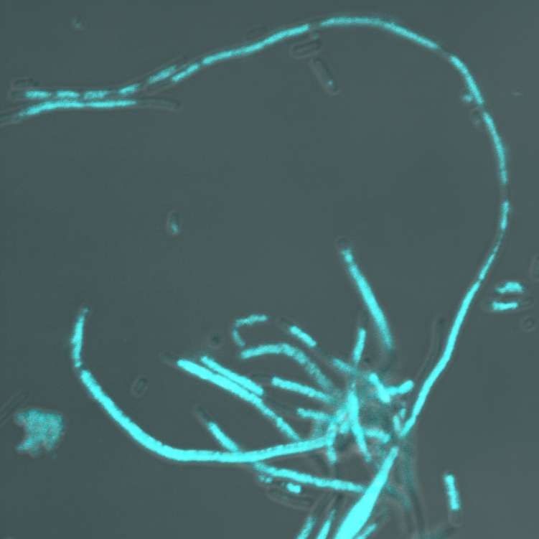
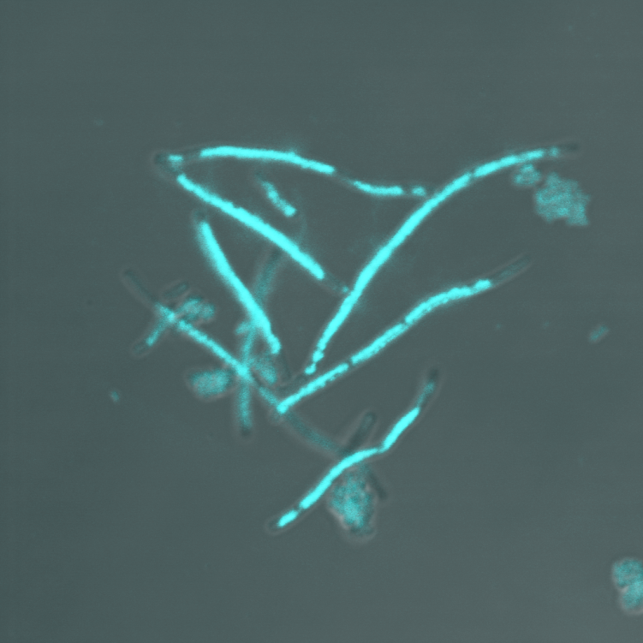
topA gyrB(Ts) rnhA
+pPH1243
topA gyrB(Ts) rnhA dnaT
+pPH1243

