Slide 1
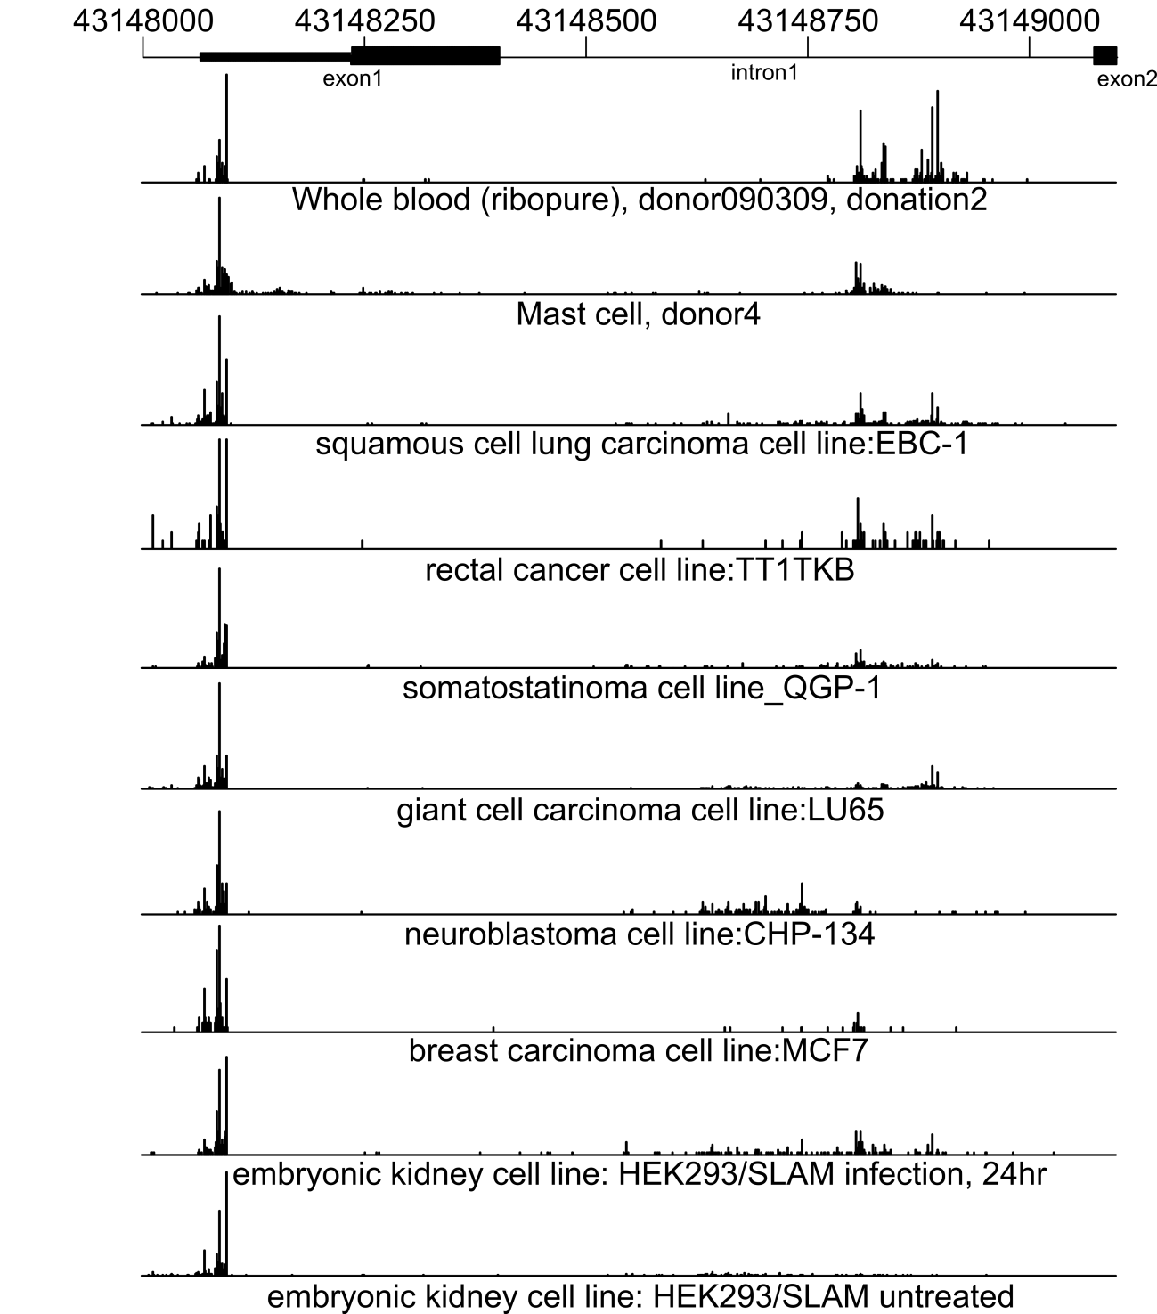
Fig. S4. YB-1 transcription initiation region studied by HeliScopeCAGE (Forrest et al., 2014; Nature). Data for several selected cell types are shown. The minor TSSs in the intronic region show visible activity. The X axis corresponds to the genomic coordinates with the gene structure shown at the top panel. The height of the bars is proportional to the number of mRNAs transcribed from a particular position.

